Slide 1
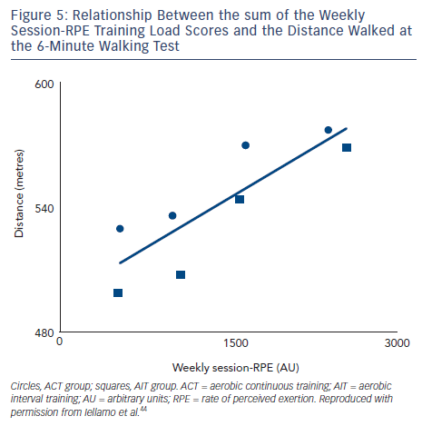
Volterrani M, Iellamo F
Relationship Between the sum of the Weekly Session-RPE Training Load Scores and the Distance Walked at the 6-Minute Walking Test
Citation: Cardiac Failure Review 2016;2(1):63–8
https://doi.org/10.15420/cfr.2015:26:1

