Slide 1
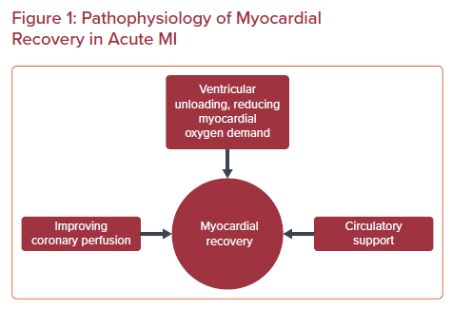
Kumar S, Feroze R, Forouzandeh F
Pathophysiology of Myocardial Recovery in Acute MI
Citation: US Cardiology Review 2023;17:e04.
https://doi.org/10.15420/usc.2022.32

