Slide 1
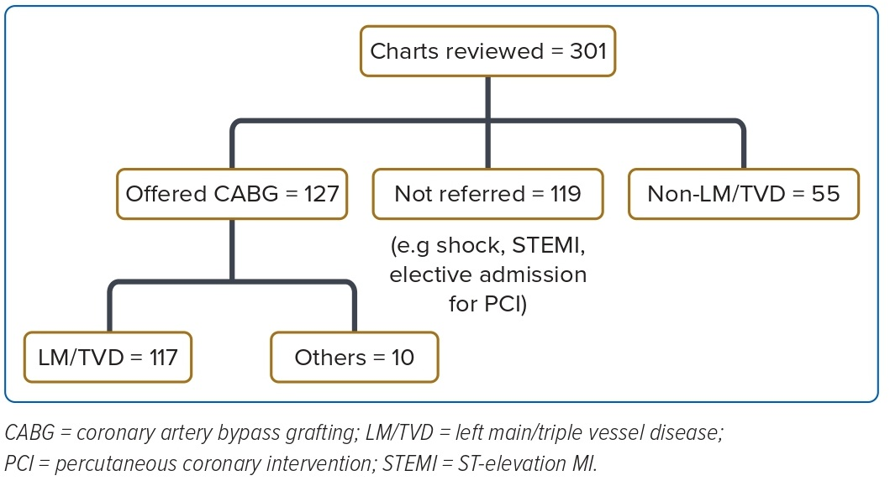
Low YH, Ren Sng GG, Quan Koh SJ, Yap JJL, Lau YH, Ting Tan DY, Jiang Y, Sin KYK, Yeo KK
Figure 1: Patient Selection
Citation: Journal of Asian Pacific Society of Cardiology 2023;2:e12.
https://doi.org/10.15420/japsc.2022.31

