Slide 1
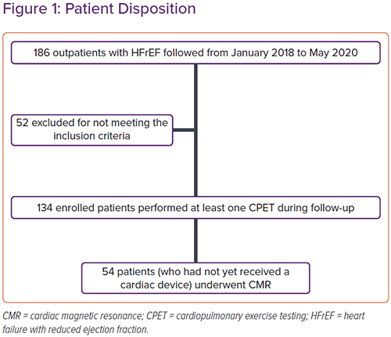
Nugara C, Giallauria F, Vitale G, Sarullo S, Gentile G, Clemenza F, Lo Voi A, Zarcone A, Venturini E, Iannuzzo G, Coats AJ, Sarullo F
Figure 1: Patient Disposition
Citation: Cardiac Failure Review 2023;8:e07.
https://doi.org/10.15420/cfr.2022.13

