Slide 1

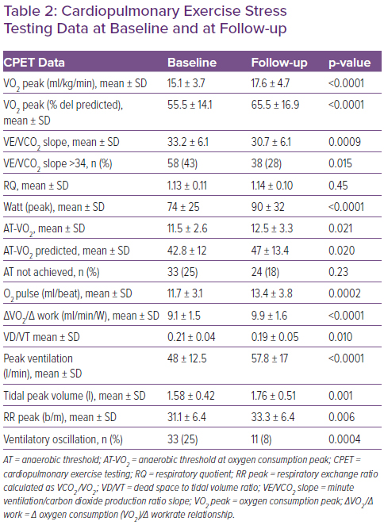
Nugara C, Giallauria F, Vitale G, Sarullo S, Gentile G, Clemenza F, Lo Voi A, Zarcone A, Venturini E, Iannuzzo G, Coats AJ, Sarullo F
Table 2: Cardiopulmonary Exercise Stress Testing Data at Baseline and at Follow-Up
Citation: Cardiac Failure Review 2023;8:e07.
https://doi.org/10.15420/cfr.2022.13

