Slide 1
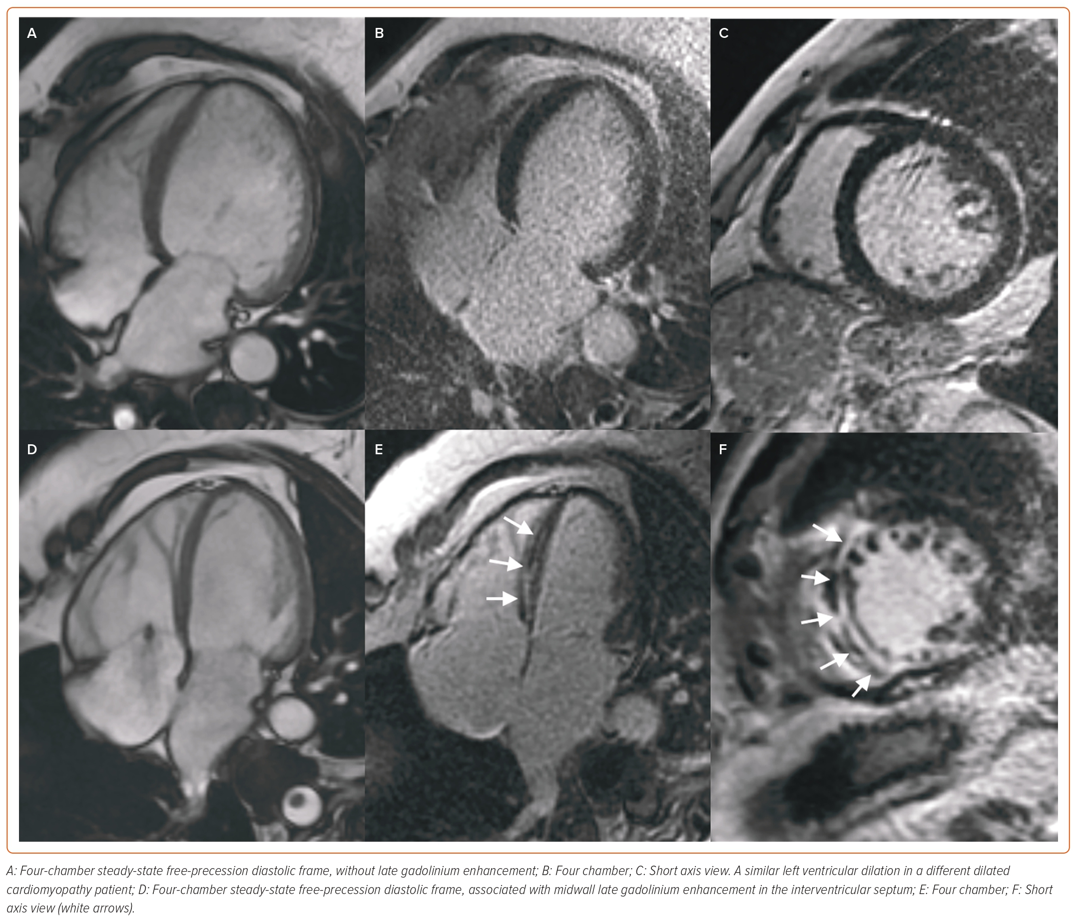
Castiglione V, Aimo A, Todiere G, Barison A, Fabiani I, Panichella G, Genovesi D, Bonino L, Clemente A, Cademartiri F, Giannoni A, Passino C, Emdin M, Vergaro G
Figure 2: Cardiac Magnetic Resonance in Dilated Cardiomyopathy Left Ventricular Dilation in a Patient with Dilated Cardiomyopathy
Citation: Cardiac Failure Review 2023;9:e08.
https://doi.org/10.15420/cfr.2022.26

