Slide 1
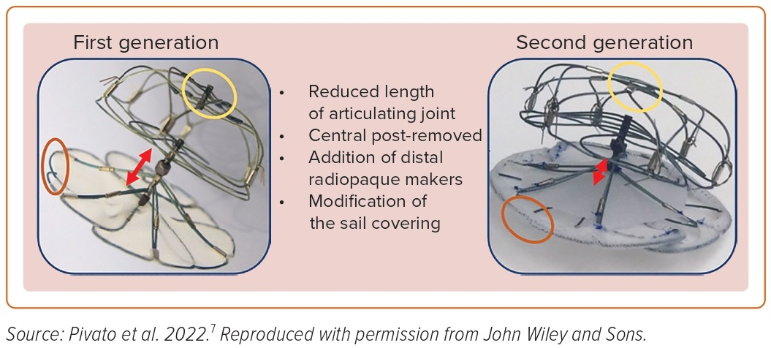
Bavishi C
Figure 2: Transcatheter Left Atrial Appendage Closure Devices: First- and Second-generation Ultraseal Devices
Citation: US Cardiology Review 2023;17:e05.
https://doi.org/10.15420/usc.2022.37

