Slide 1
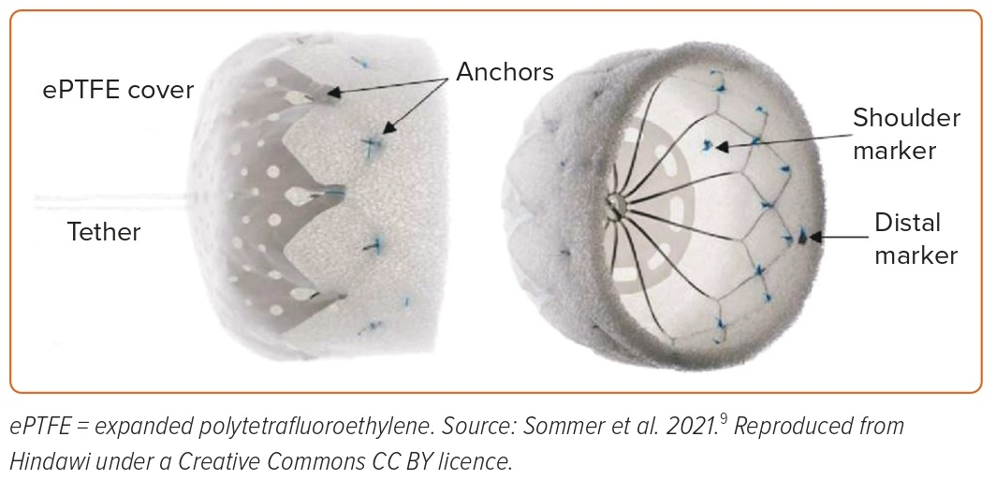
Bavishi C
Figure 4: Transcatheter Left Atrial Appendage Closure Device: The Lambre Device
Citation: US Cardiology Review 2023;17:e05.
https://doi.org/10.15420/usc.2022.37

