Slide 1
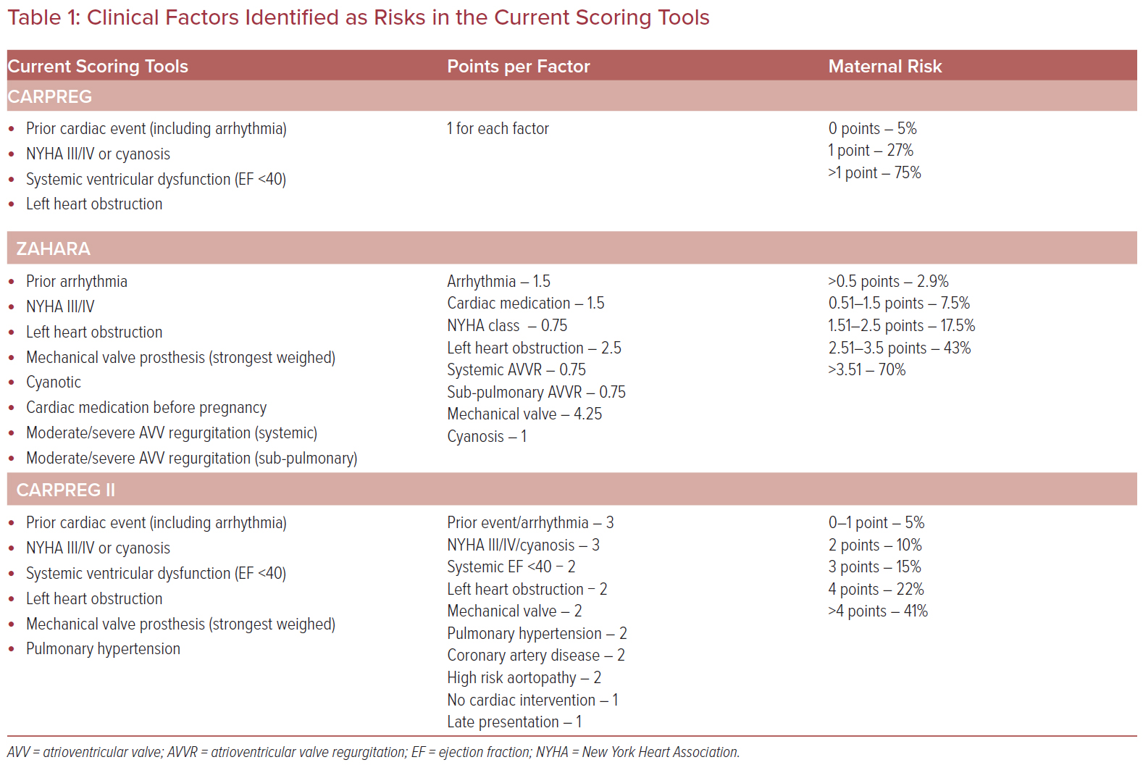
Kulasekaran A, Swan L
Table 1: Clinical Factors Identified as Risks in the Current Scoring Tools
Citation: US Cardiology Review 2023;17:e06.
https://doi.org/10.15420/usc.2022.16

