Slide 1
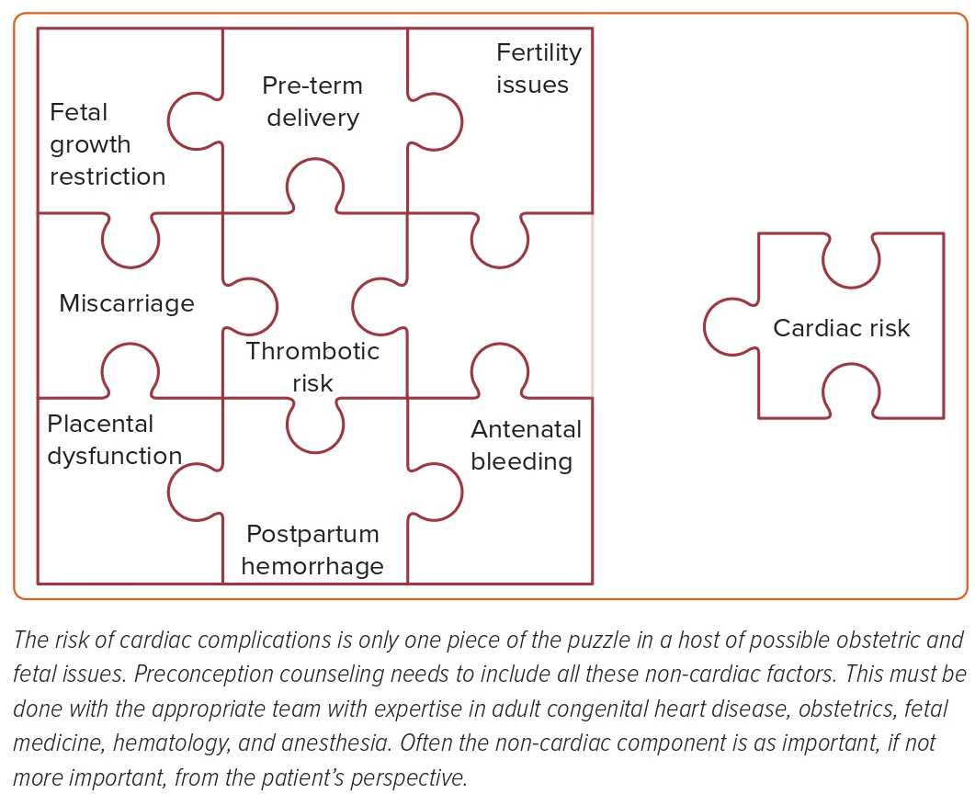
Kulasekaran A, Swan L
Figure 2: Pre-conception Counseling in Patients with a Fontan Circulation
Citation: US Cardiology Review 2023;17:e06.
https://doi.org/10.15420/usc.2022.16

