Slide 1
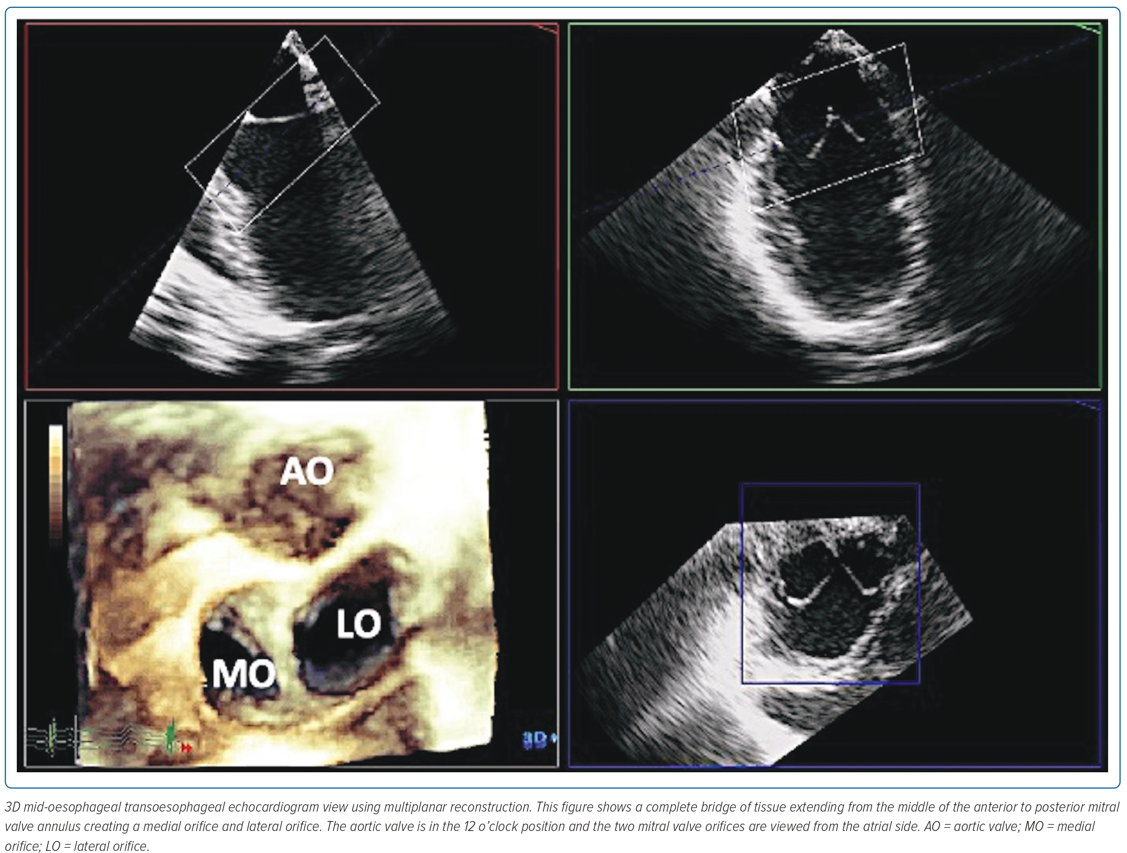
Quetulio MLR, Llabado GAE, Kathryn I Pineda AM, Sison JA, Cajigal JM
Figure 4: 3D Transoesophageal View
Citation: Journal of Asian Pacific Society of Cardiology 2023;2:e13
https://doi.org/10.15420/japsc.2022.35

