Slide 1
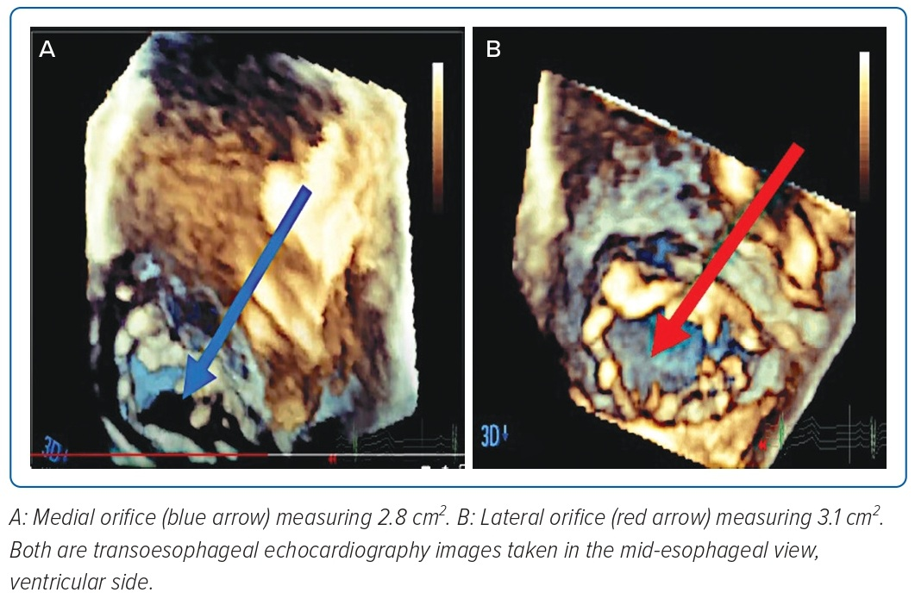
Quetulio MLR, Llabado GAE, Kathryn I Pineda AM, Sison JA, Cajigal JM
Figure 5: Transoesophageal Echocardiogram Images: 3D Multiplanar Reconstruction
Citation: Journal of Asian Pacific Society of Cardiology 2023;2:e13
https://doi.org/10.15420/japsc.2022.35

