Slide 1
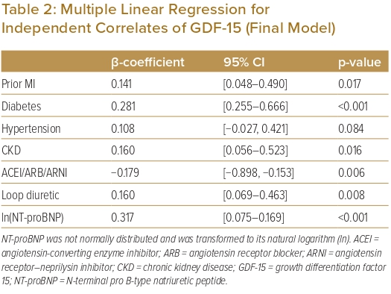
Cham YL, Fong AYY, Kiong Chung JB, Ling HS, Pang IX, Thien LK, Bin Chow H, En Zhe Chan I, Shu FEP, Tan CT, Koh KT, Oon YY, Said A, Ong TK
Multiple Linear Regression for Independent Correlates of GDF-15 (Final Model)
Citation: Journal of Asian Pacific Society of Cardiology 2023;2:e14.
https://doi.org/10.15420/japsc.2022.06

