Slide 1
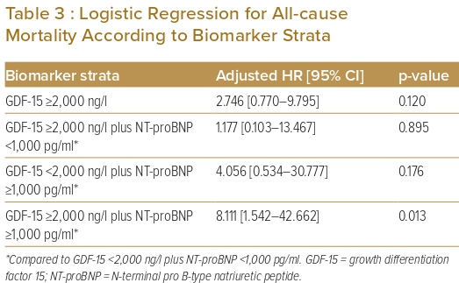
Cham YL, Fong AYY, Kiong Chung JB, Ling HS, Pang IX, Thien LK, Bin Chow H, En Zhe Chan I, Shu FEP, Tan CT, Koh KT, Oon YY, Said A, Ong TK
Logistic Regression for All-cause Mortality According to Biomarker Strata
Citation: Journal of Asian Pacific Society of Cardiology 2023;2:e14.
https://doi.org/10.15420/japsc.2022.06

