Slide 1
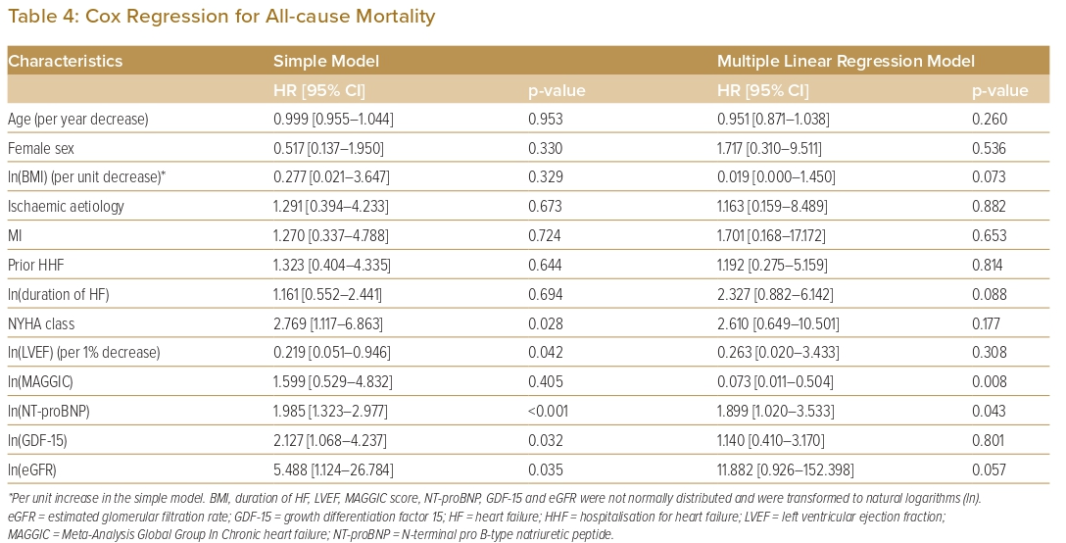
Cham YL, Fong AYY, Kiong Chung JB, Ling HS, Pang IX, Thien LK, Bin Chow H, En Zhe Chan I, Shu FEP, Tan CT, Koh KT, Oon YY, Said A, Ong TK
Cox Regression for All-cause Mortality
Citation: Journal of Asian Pacific Society of Cardiology 2023;2:e14.
https://doi.org/10.15420/japsc.2022.06

