Slide 1
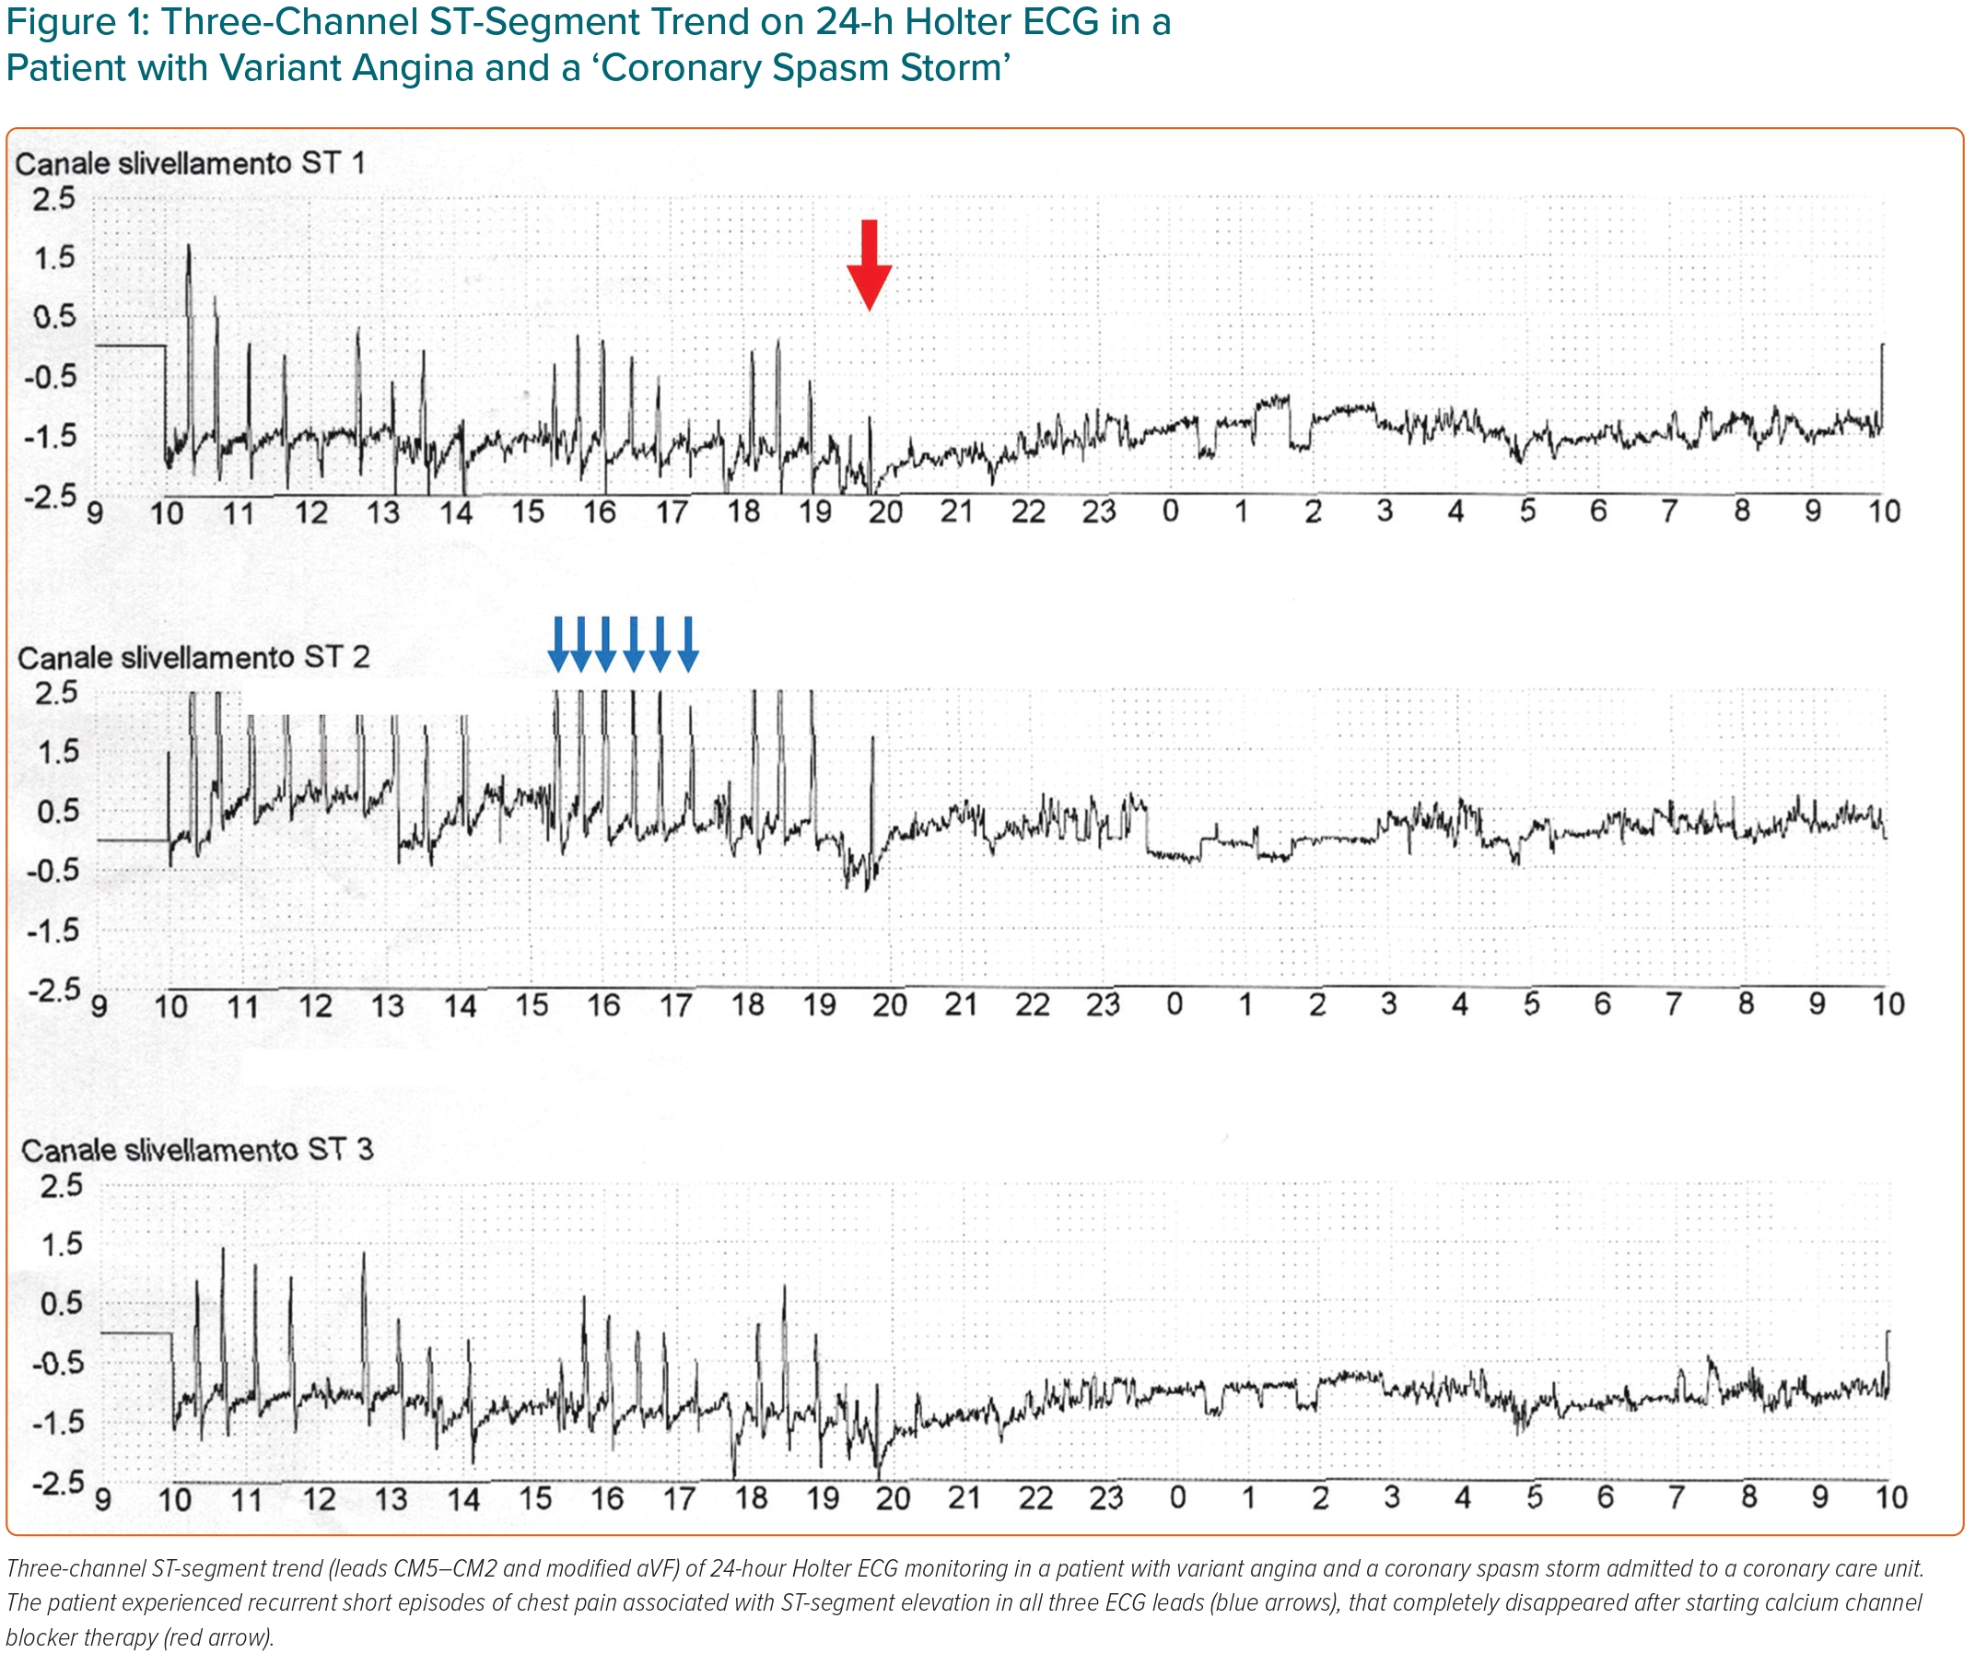
Lanza GA, Shimokawa H
Figure 1: Three-Channel ST-Segment Trend on 24-h Holter ECG in a Patient with Variant Angina and a ‘Coronary Spasm Storm’
Citation: European Cardiology Review 2023;18:e38.
https://doi.org/10.15420/ecr.2022.47

