Slide 1
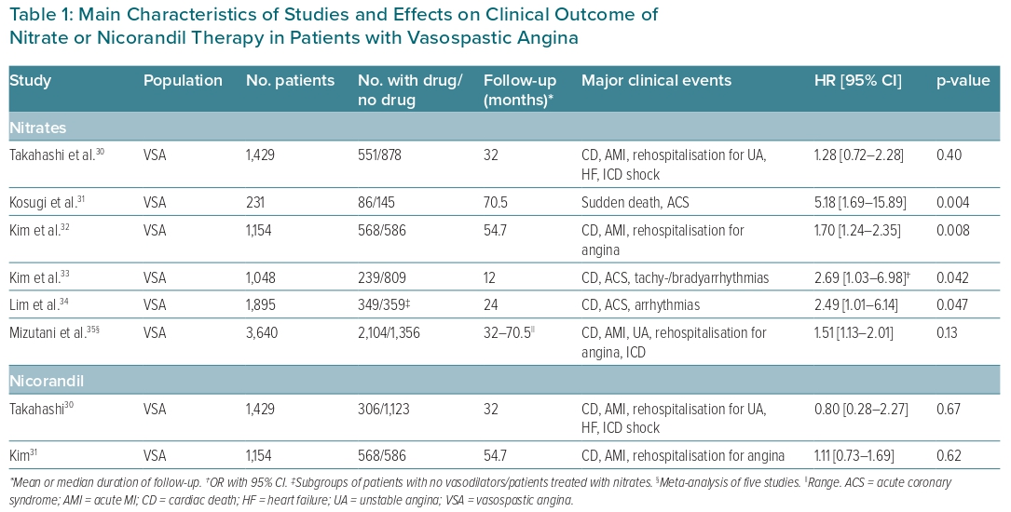
Lanza GA, Shimokawa H
Table 1: Main Characteristics of Studies and Effects on Clinical Outcome of Nitrate or Nicorandil Therapy in Patients with Vasospastic Angina
Citation: European Cardiology Review 2023;18:e38.
https://doi.org/10.15420/ecr.2022.47

