Slide 1
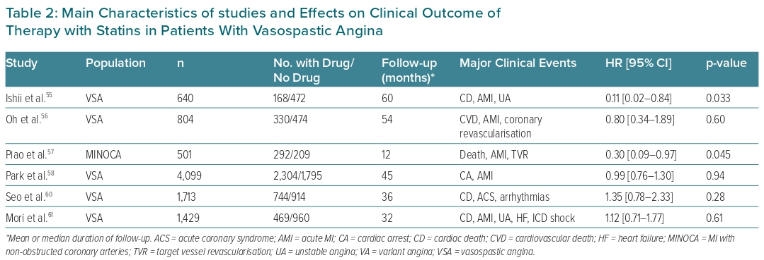
Lanza GA, Shimokawa H
Table 2: Main Characteristics of studies and Effects on Clinical Outcome of Therapy with Statins in Patients With Vasospastic Angina
Citation: European Cardiology Review 2023;18:e38.
https://doi.org/10.15420/ecr.2022.47

