Slide 1
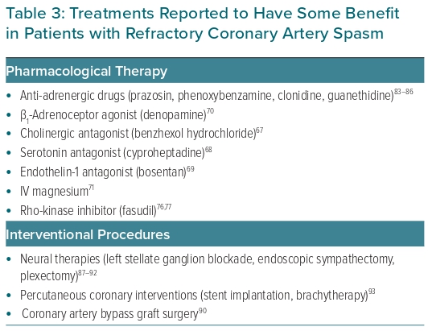
Lanza GA, Shimokawa H
Table 3: Treatments Reported to Have Some Benefit in Patients with Refractory Coronary Artery Spasm
Citation: European Cardiology Review 2023;18:e38.
https://doi.org/10.15420/ecr.2022.47

