Slide 1
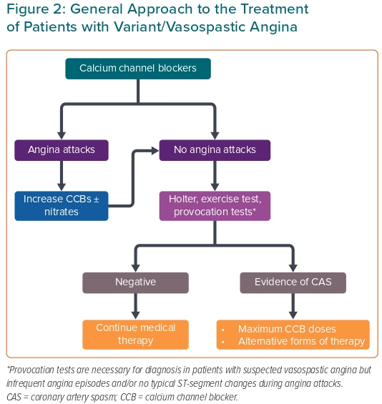
Lanza GA, Shimokawa H
Figure 2: General Approach to the Treatment of Patients with Variant/Vasospastic Angina
Citation: European Cardiology Review 2023;18:e38.
https://doi.org/10.15420/ecr.2022.47

