Slide 1
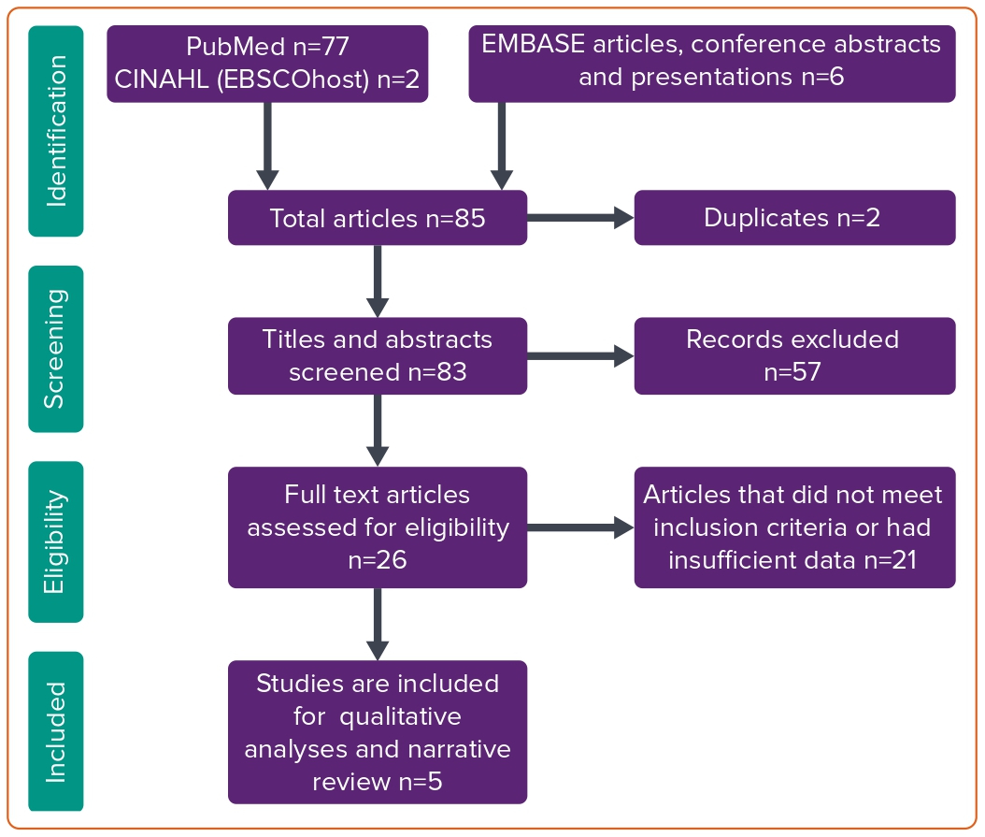
Sattar Y, Sengodan PM, Sajjad Cheema M, Javed N, Ashraf S, Fakhra S, Alharbi A, Syed M, Alam M, Elgendy IY, Haleem A, Kawsara A, Alraies MC, Daggubati R
Figure 1: Preferred Reporting Items for Systematic Reviews and Meta-Analyses Flow of the Search Strategy for Systematic Review and Meta-analysis
Citation: Interventional Cardiology 2023;18:e18.
https://doi.org/10.15420/icr.2023.10

