Slide 1
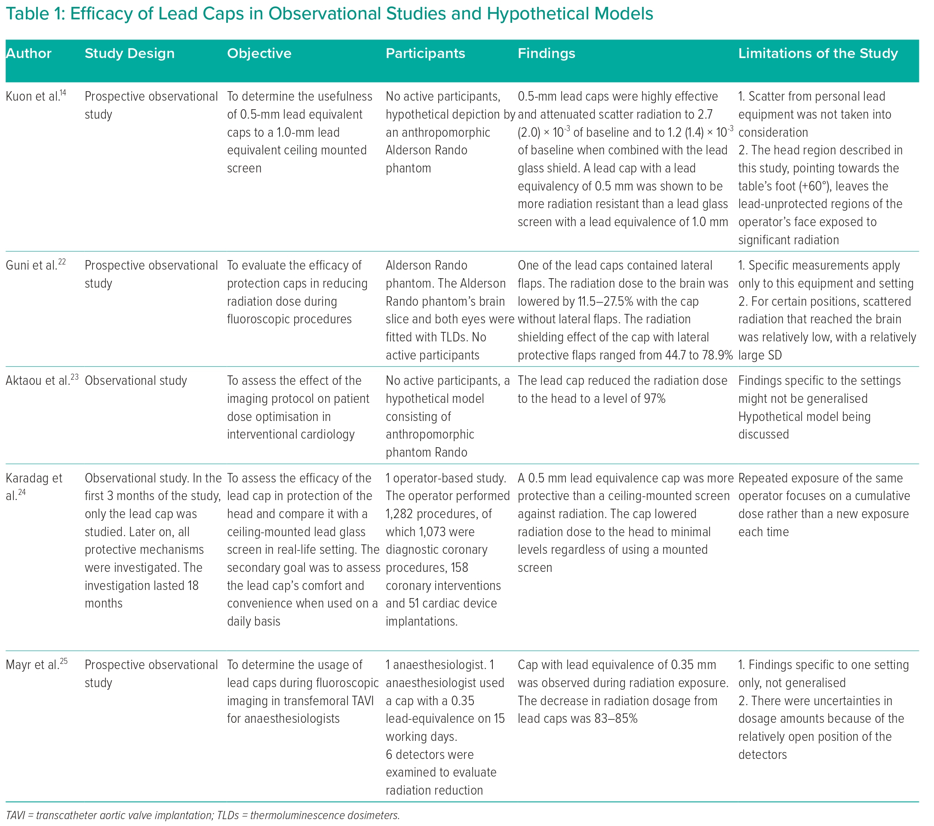
Sattar Y, Sengodan PM, Sajjad Cheema M, Javed N, Ashraf S, Fakhra S, Alharbi A, Syed M, Alam M, Elgendy IY, Haleem A, Kawsara A, Alraies MC, Daggubati R
Table 1: Efficacy of Lead Caps in Observational Studies and Hypothetical Models
Citation: Interventional Cardiology 2023;18:e18.
https://doi.org/10.15420/icr.2023.10

