Slide 1
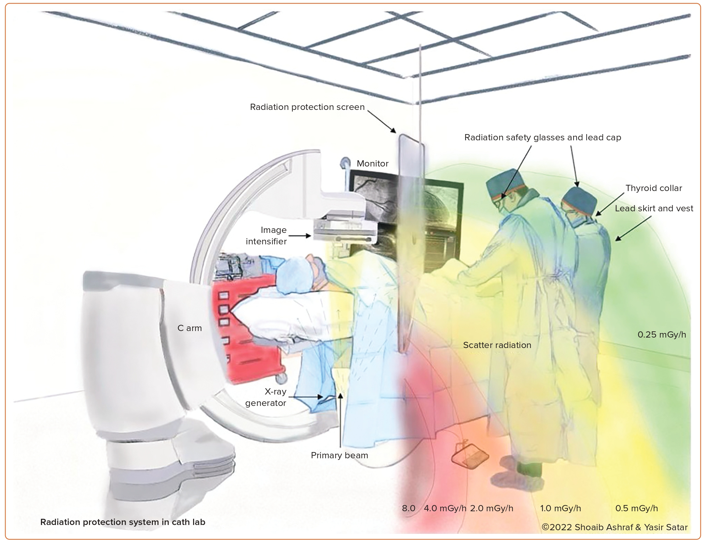
Sattar Y, Sengodan PM, Sajjad Cheema M, Javed N, Ashraf S, Fakhra S, Alharbi A, Syed M, Alam M, Elgendy IY, Haleem A, Kawsara A, Alraies MC, Daggubati R
Figure 2: Radiation Protection System in the Cardiac Catheterisation Laboratory: Commonly Employed Strategies to Minimise Radiation Exposure are Safety Cap, Glasses, Lead Skirt and Vest with Thyroid Collar and Radiation Protection Shield
Citation: Interventional Cardiology 2023;18:e18.
https://doi.org/10.15420/icr.2023.10

