Slide 1
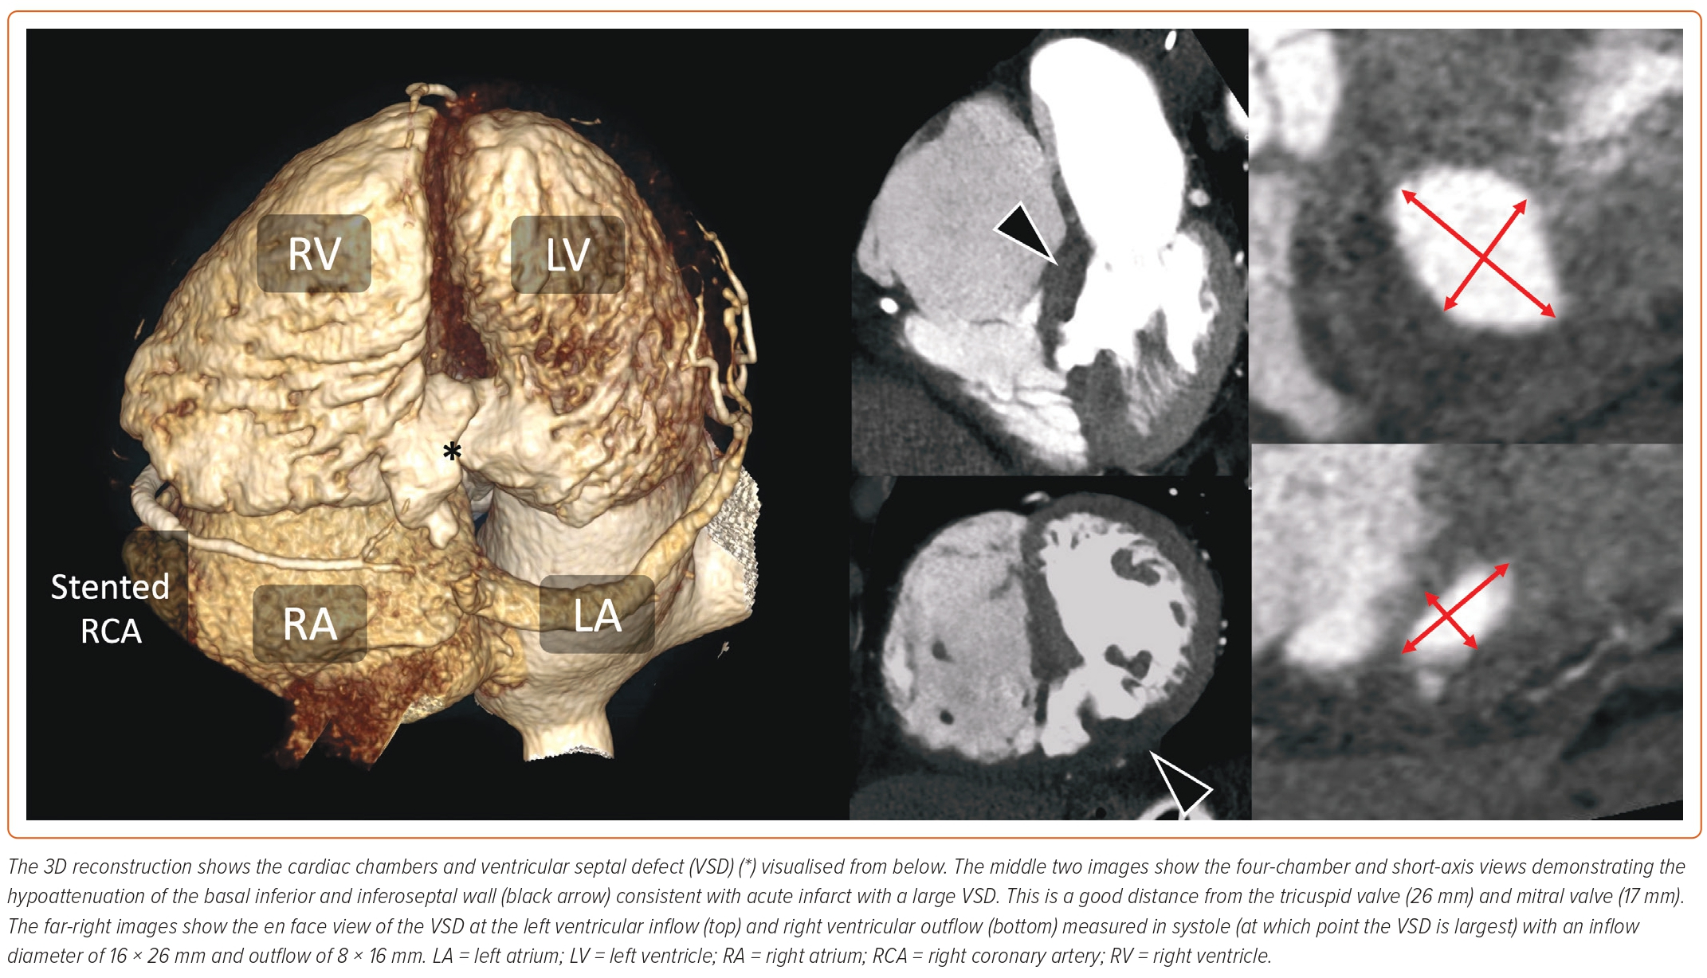
Cadogan D, Daghem M, Snosi M, Williams LK, Weir-McCall J, Calvert PA, Giblett JP
Figure 1: Cardiac CT Assessment of a Basal Inferoseptal Ventricular Septal Defect
Citation: Interventional Cardiology 2023;18:e19.
https://doi.org/10.15420/icr.2023.01

