Slide 1
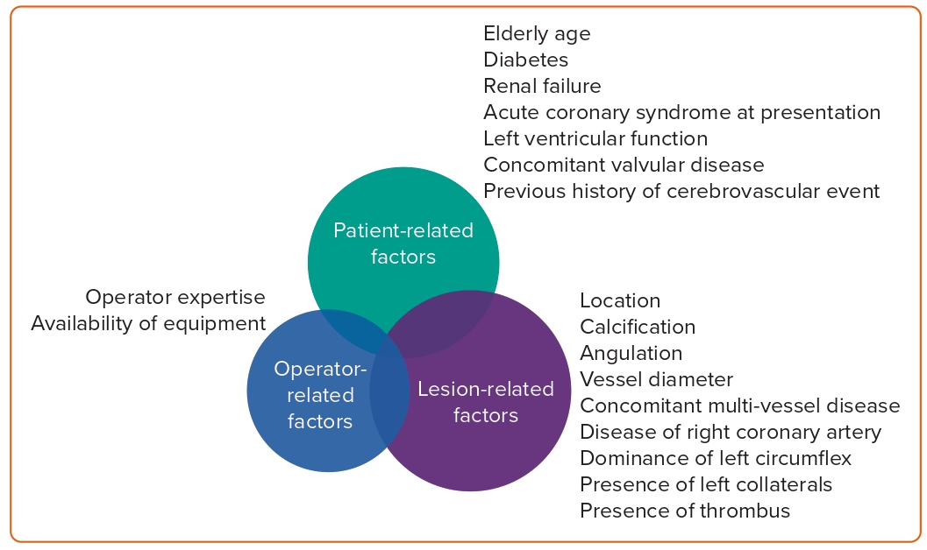
Showkathali R, Priya Yalamanchi R
Figure 2: Factors Involved in Decision Making in Left Main Coronary Artery Management
Citation: Interventional Cardiology 2023;18:e20.
https://doi.org/10.15420/icr.2023.02

