Slide 1
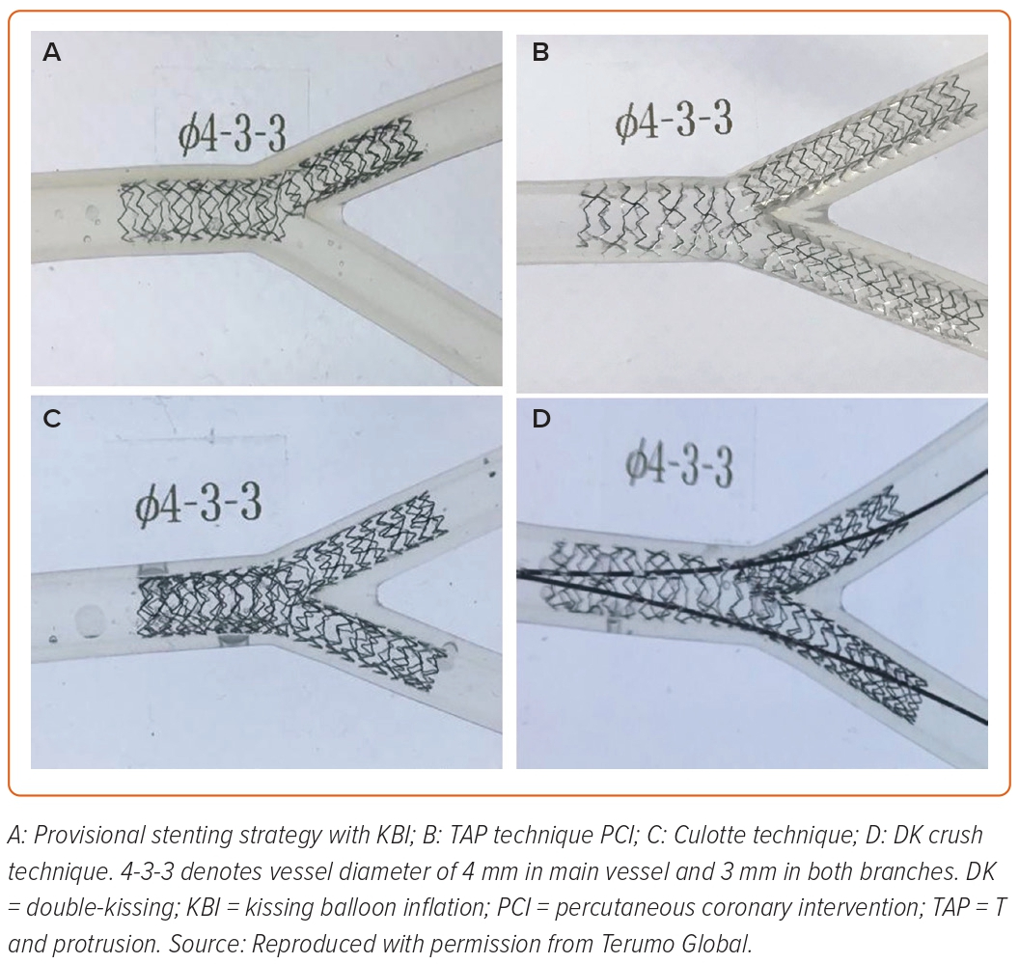
Showkathali R, Priya Yalamanchi R
Figure 4: Wet Model Images of Different Technique of Left Main Bifurcation Percutaneous Coronary Intervention
Citation: Interventional Cardiology 2023;18:e20.
https://doi.org/10.15420/icr.2023.02

