Slide 1
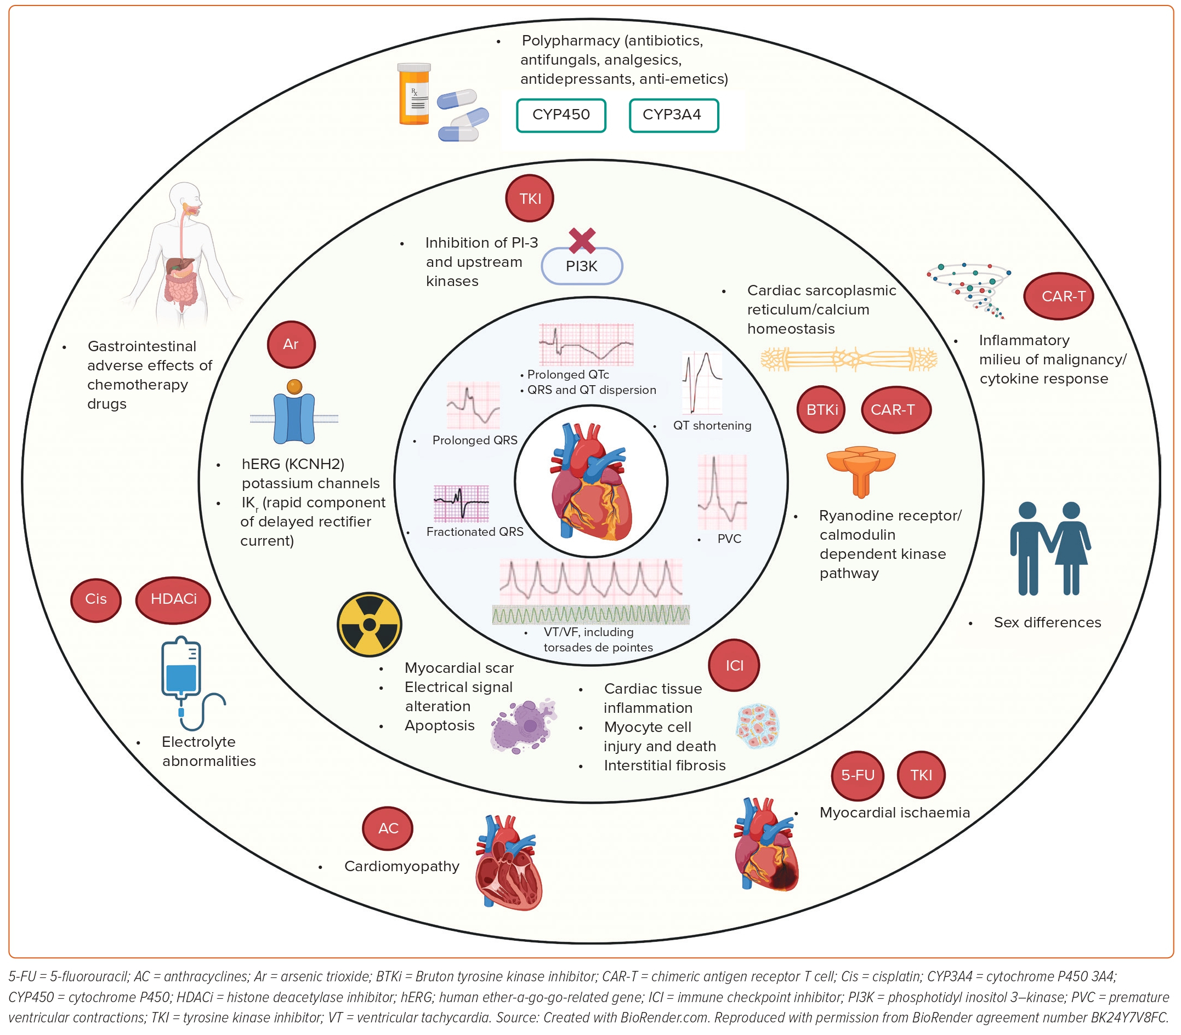
Agarwal MA, Sridharan A, Pimentel RC, Markowitz SM, Rosenfeld LE, Fradley MG, Yang EH
Figure 1: Primary and Secondary Factors Associated with Ventricular Arrhythmias in Cancer Patients
Citation: Arrhythmia & Electrophysiology Review 2023;12:e16.
https://doi.org/10.15420/aer.2023.04

