Slide 1
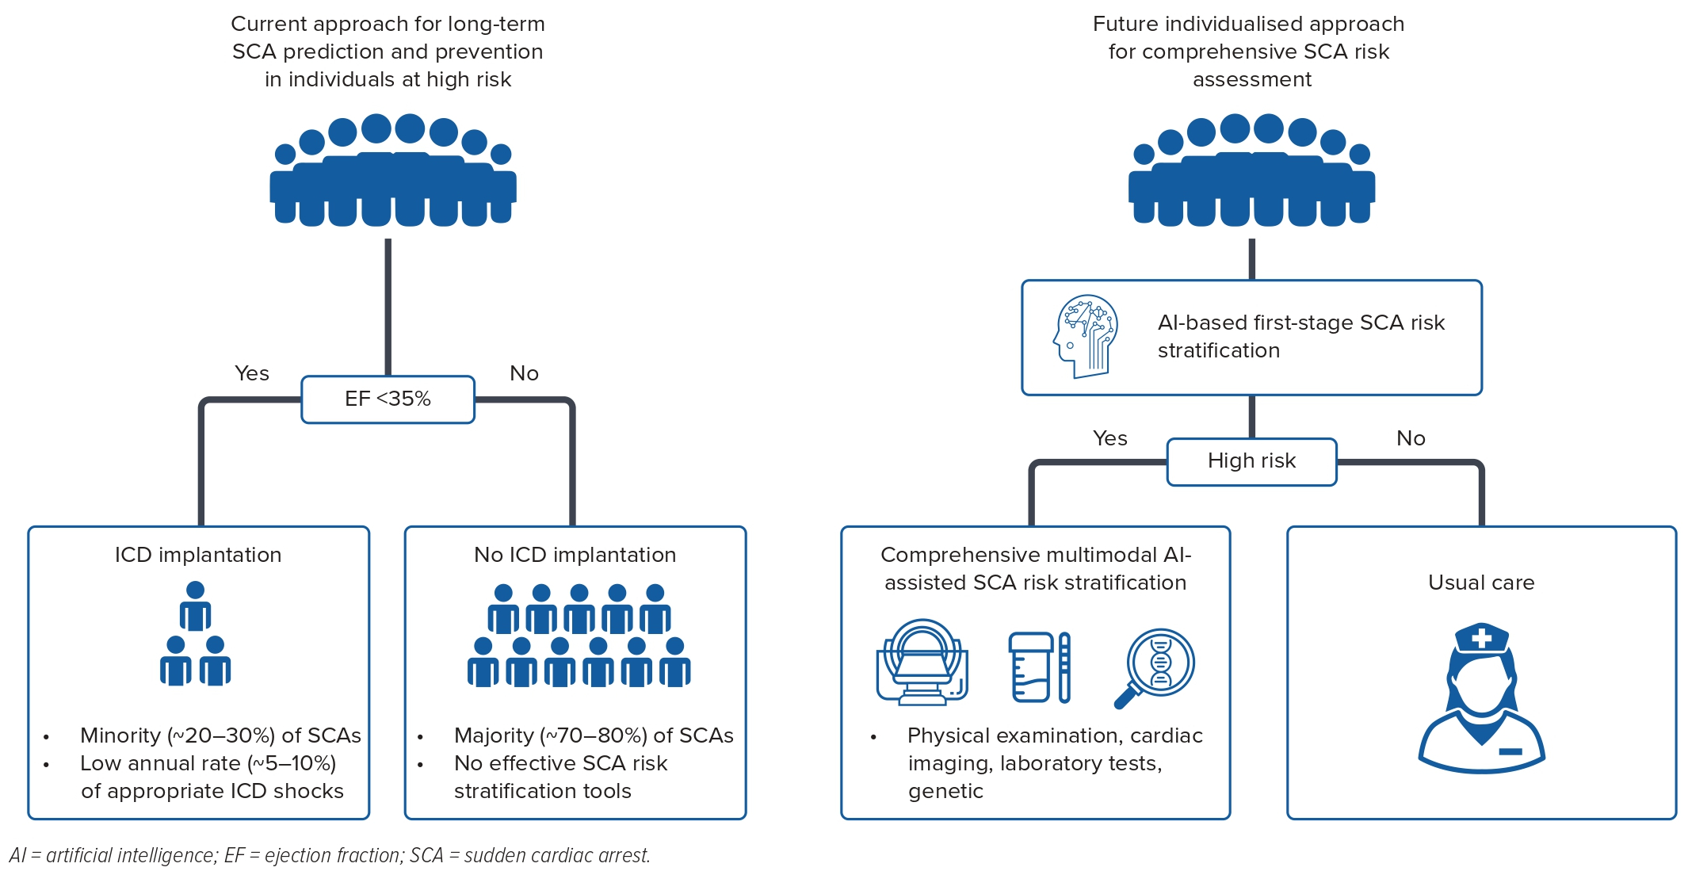
Holmström L, Zijun Zhang F, Ouyang D, Dey D, Slomka PJ, Chugh SS
Figure 1: Current Approach and Potential Future Perspectives in Long-term Sudden Cardiac Arrest Prediction
Citation: Arrhythmia & Electrophysiology Review 2023;12;e17.
https://doi.org/10.15420/aer.2022.42

