Slide 1
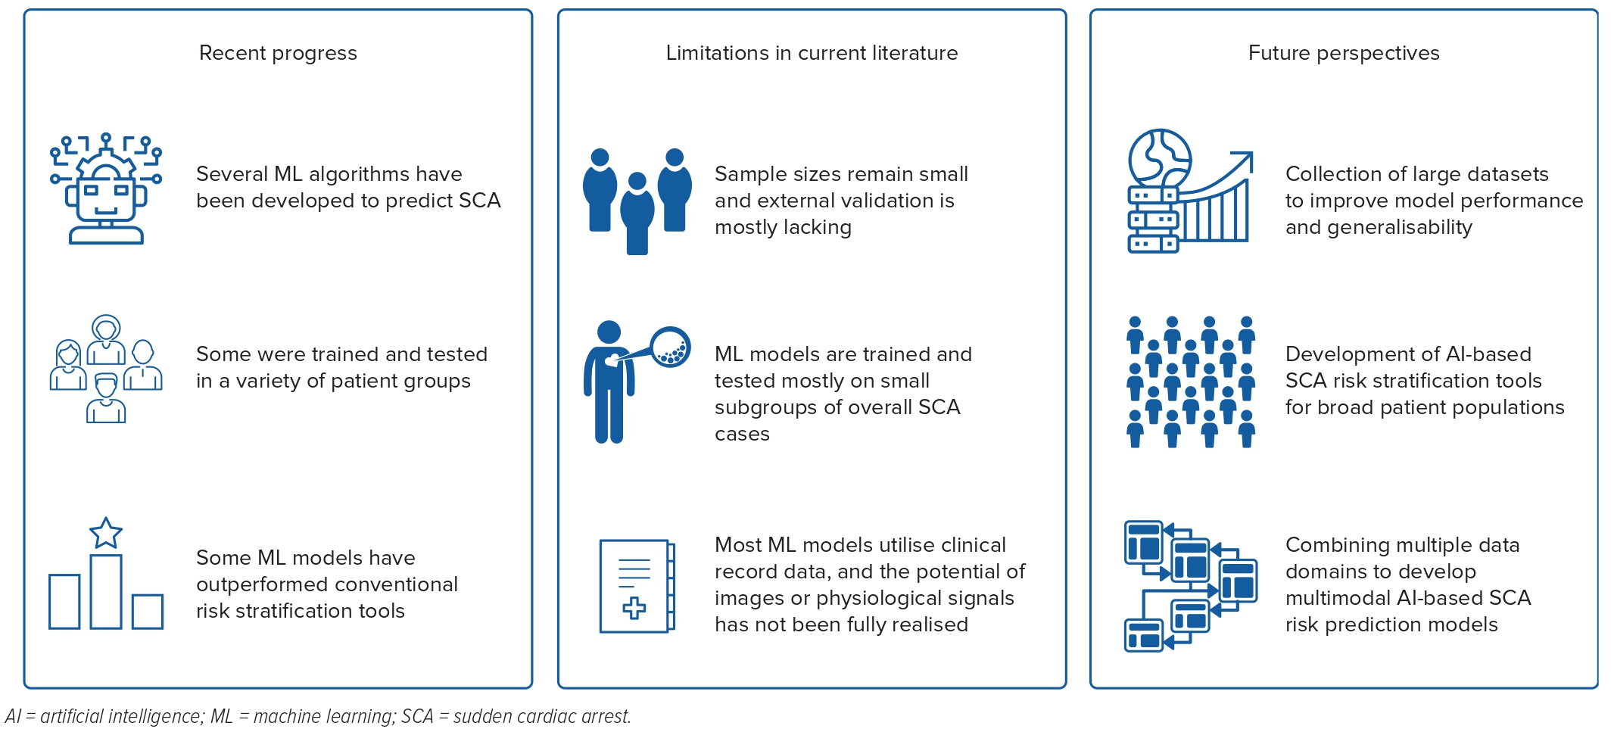
Holmström L, Zijun Zhang F, Ouyang D, Dey D, Slomka PJ, Chugh SS
Figure 3: Recent Progress, Limitations and Future Perspectives in Artificial Intelligence-based Sudden Cardiac Arrest Risk Prediction
Citation: Arrhythmia & Electrophysiology Review 2023;12;e17.
https://doi.org/10.15420/aer.2022.42

