Slide 1
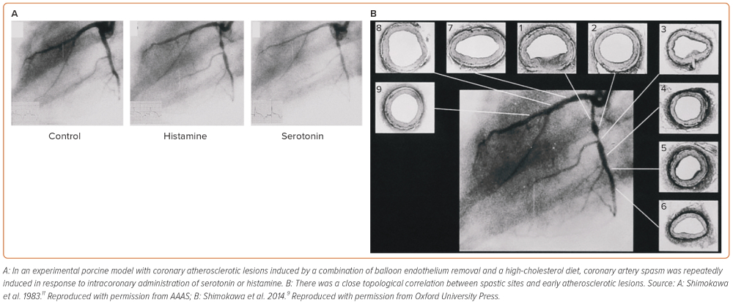
Nishimiya K, Takahashi J, Oyama K, Matsumoto Y, Yasuda S, Shimokawa H
Figure 1: Coronary Artery Spasm in a Porcine Model with Coronary Atherosclerotic Lesions
Citation: European Cardiology Review 2023;2:e39.
https://doi.org/10.15420/ecr.2022.55

