Slide 1
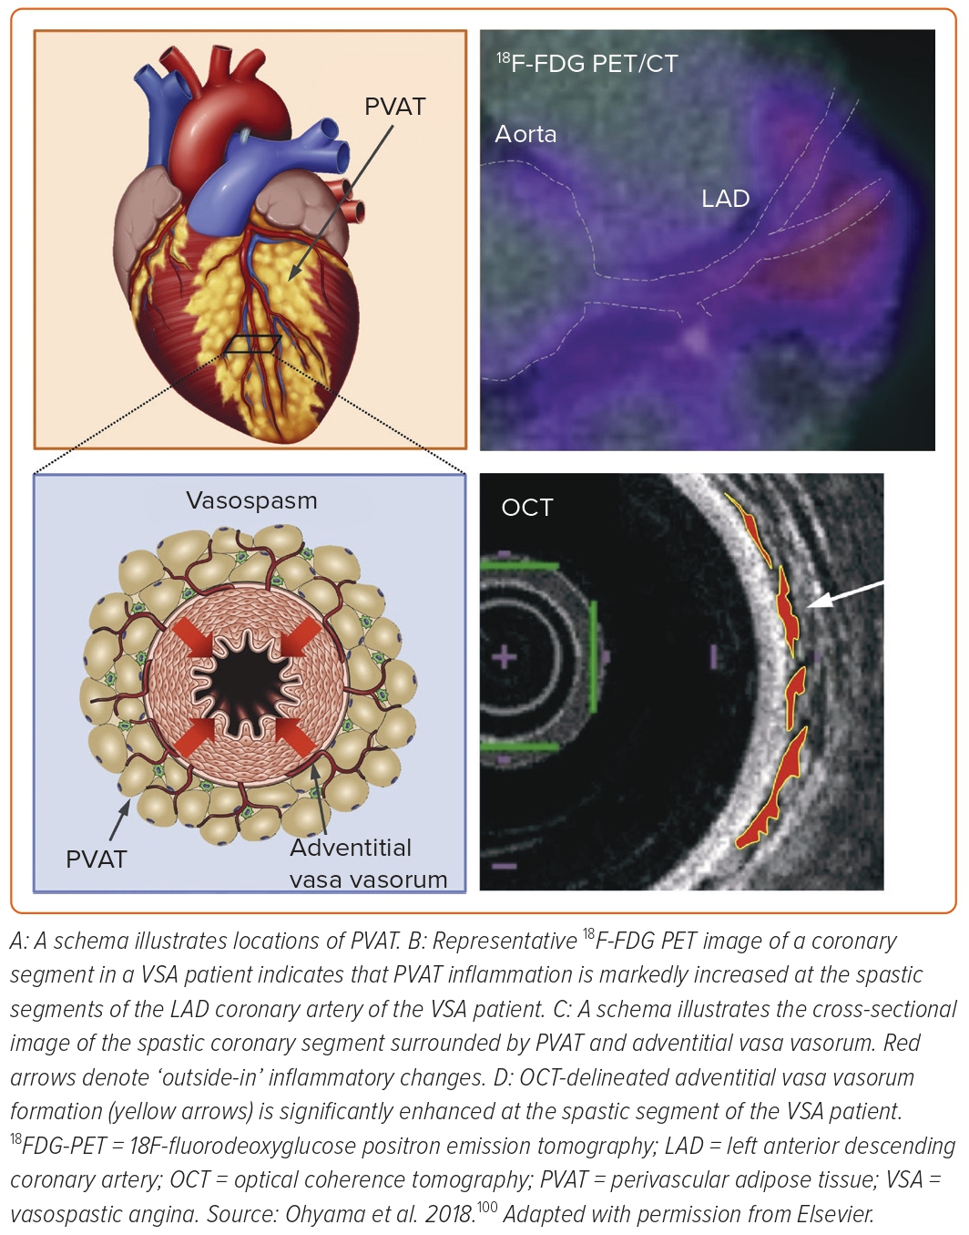
Nishimiya K, Takahashi J, Oyama K, Matsumoto Y, Yasuda S, Shimokawa H
Figure 5: Involvement of Coronary Adventitial Inflammation in the Pathogenesis of Coronary Artery Spasm
Citation: European Cardiology Review 2023;2:e39.
https://doi.org/10.15420/ecr.2022.55

