Slide 1
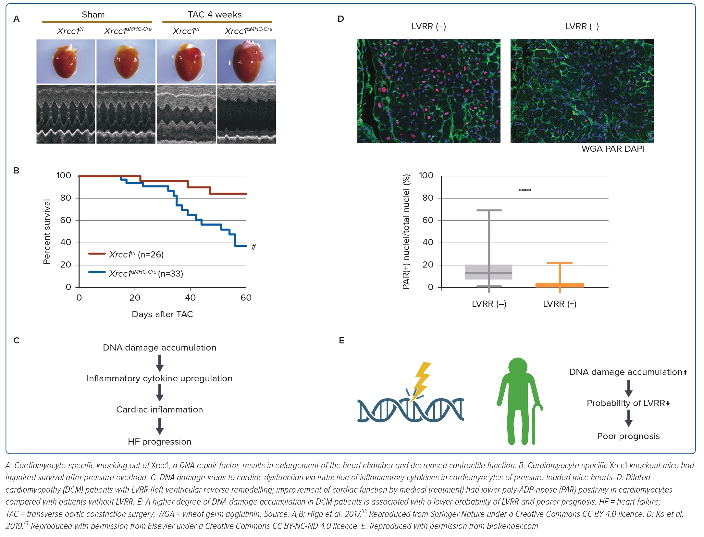
Katoh M, Ko T, Katagiri M, Yamada S, Ito M, Komuro I
Figure 2: DNA Damage Accumulation is a Cause and Prognostic Factor of Heart Failure
Citation: Journal of Asian Pacific Society of Cardiology 2023;2:e15.
https://doi.org/10.15420/japsc.2022.37

