Slide 1
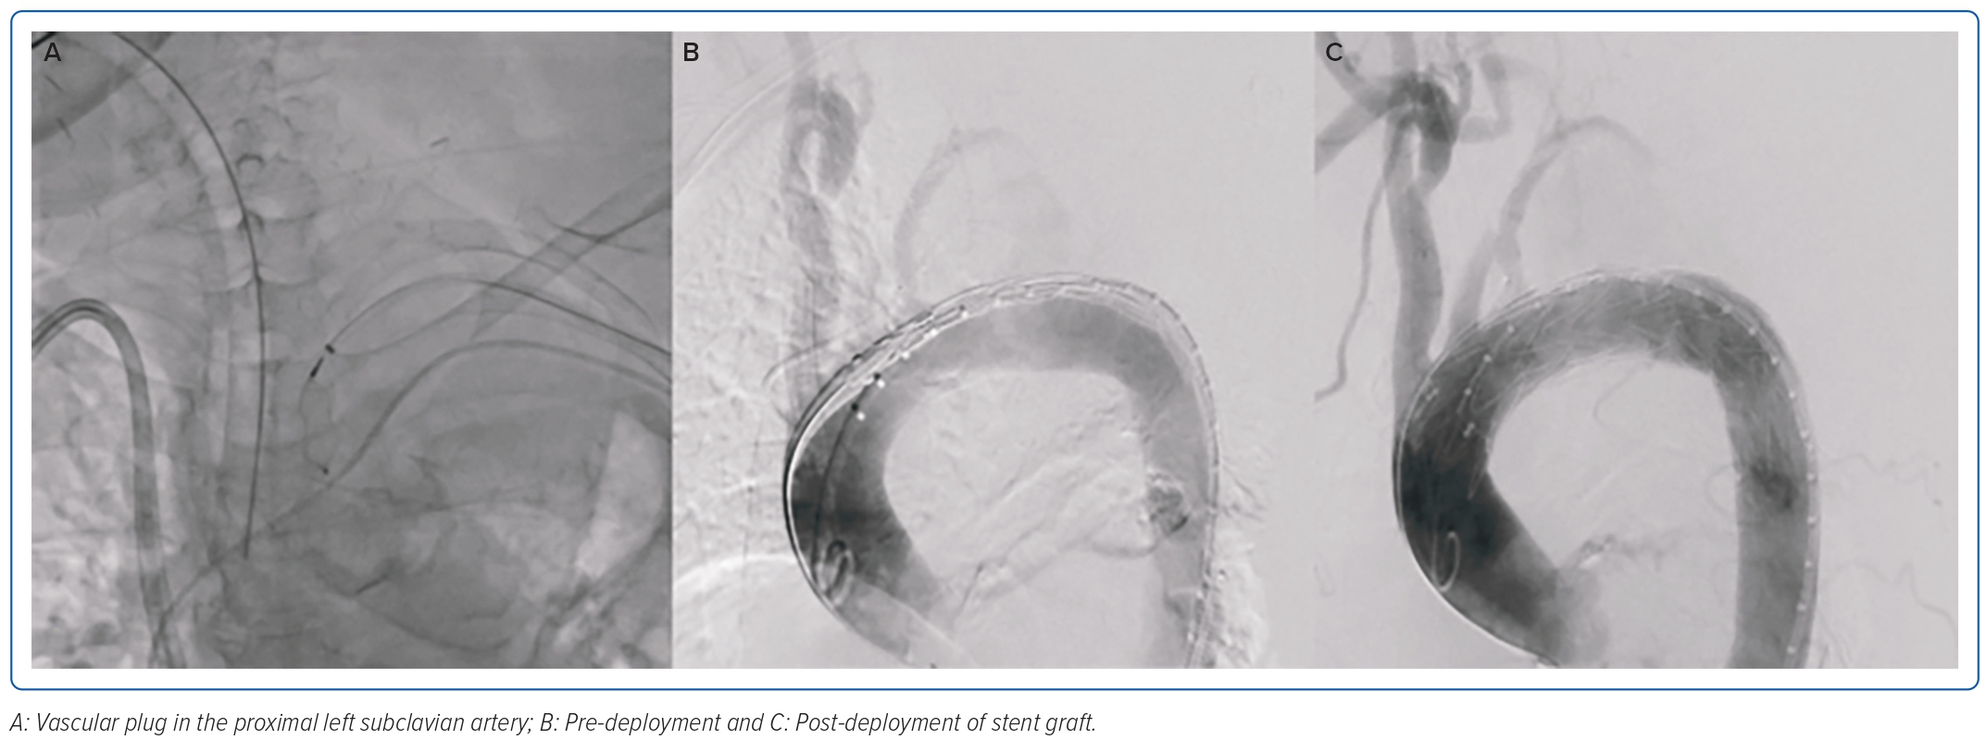
Chua APA, Toledano BRF, Paolo A Prado J
Figure 2: Cine Images of the Aorta
Citation: Journal of Asian Pacific Society of Cardiology 2023;2:e17.
https://doi.org/10.15420/japsc.2022.53

