Slide 1
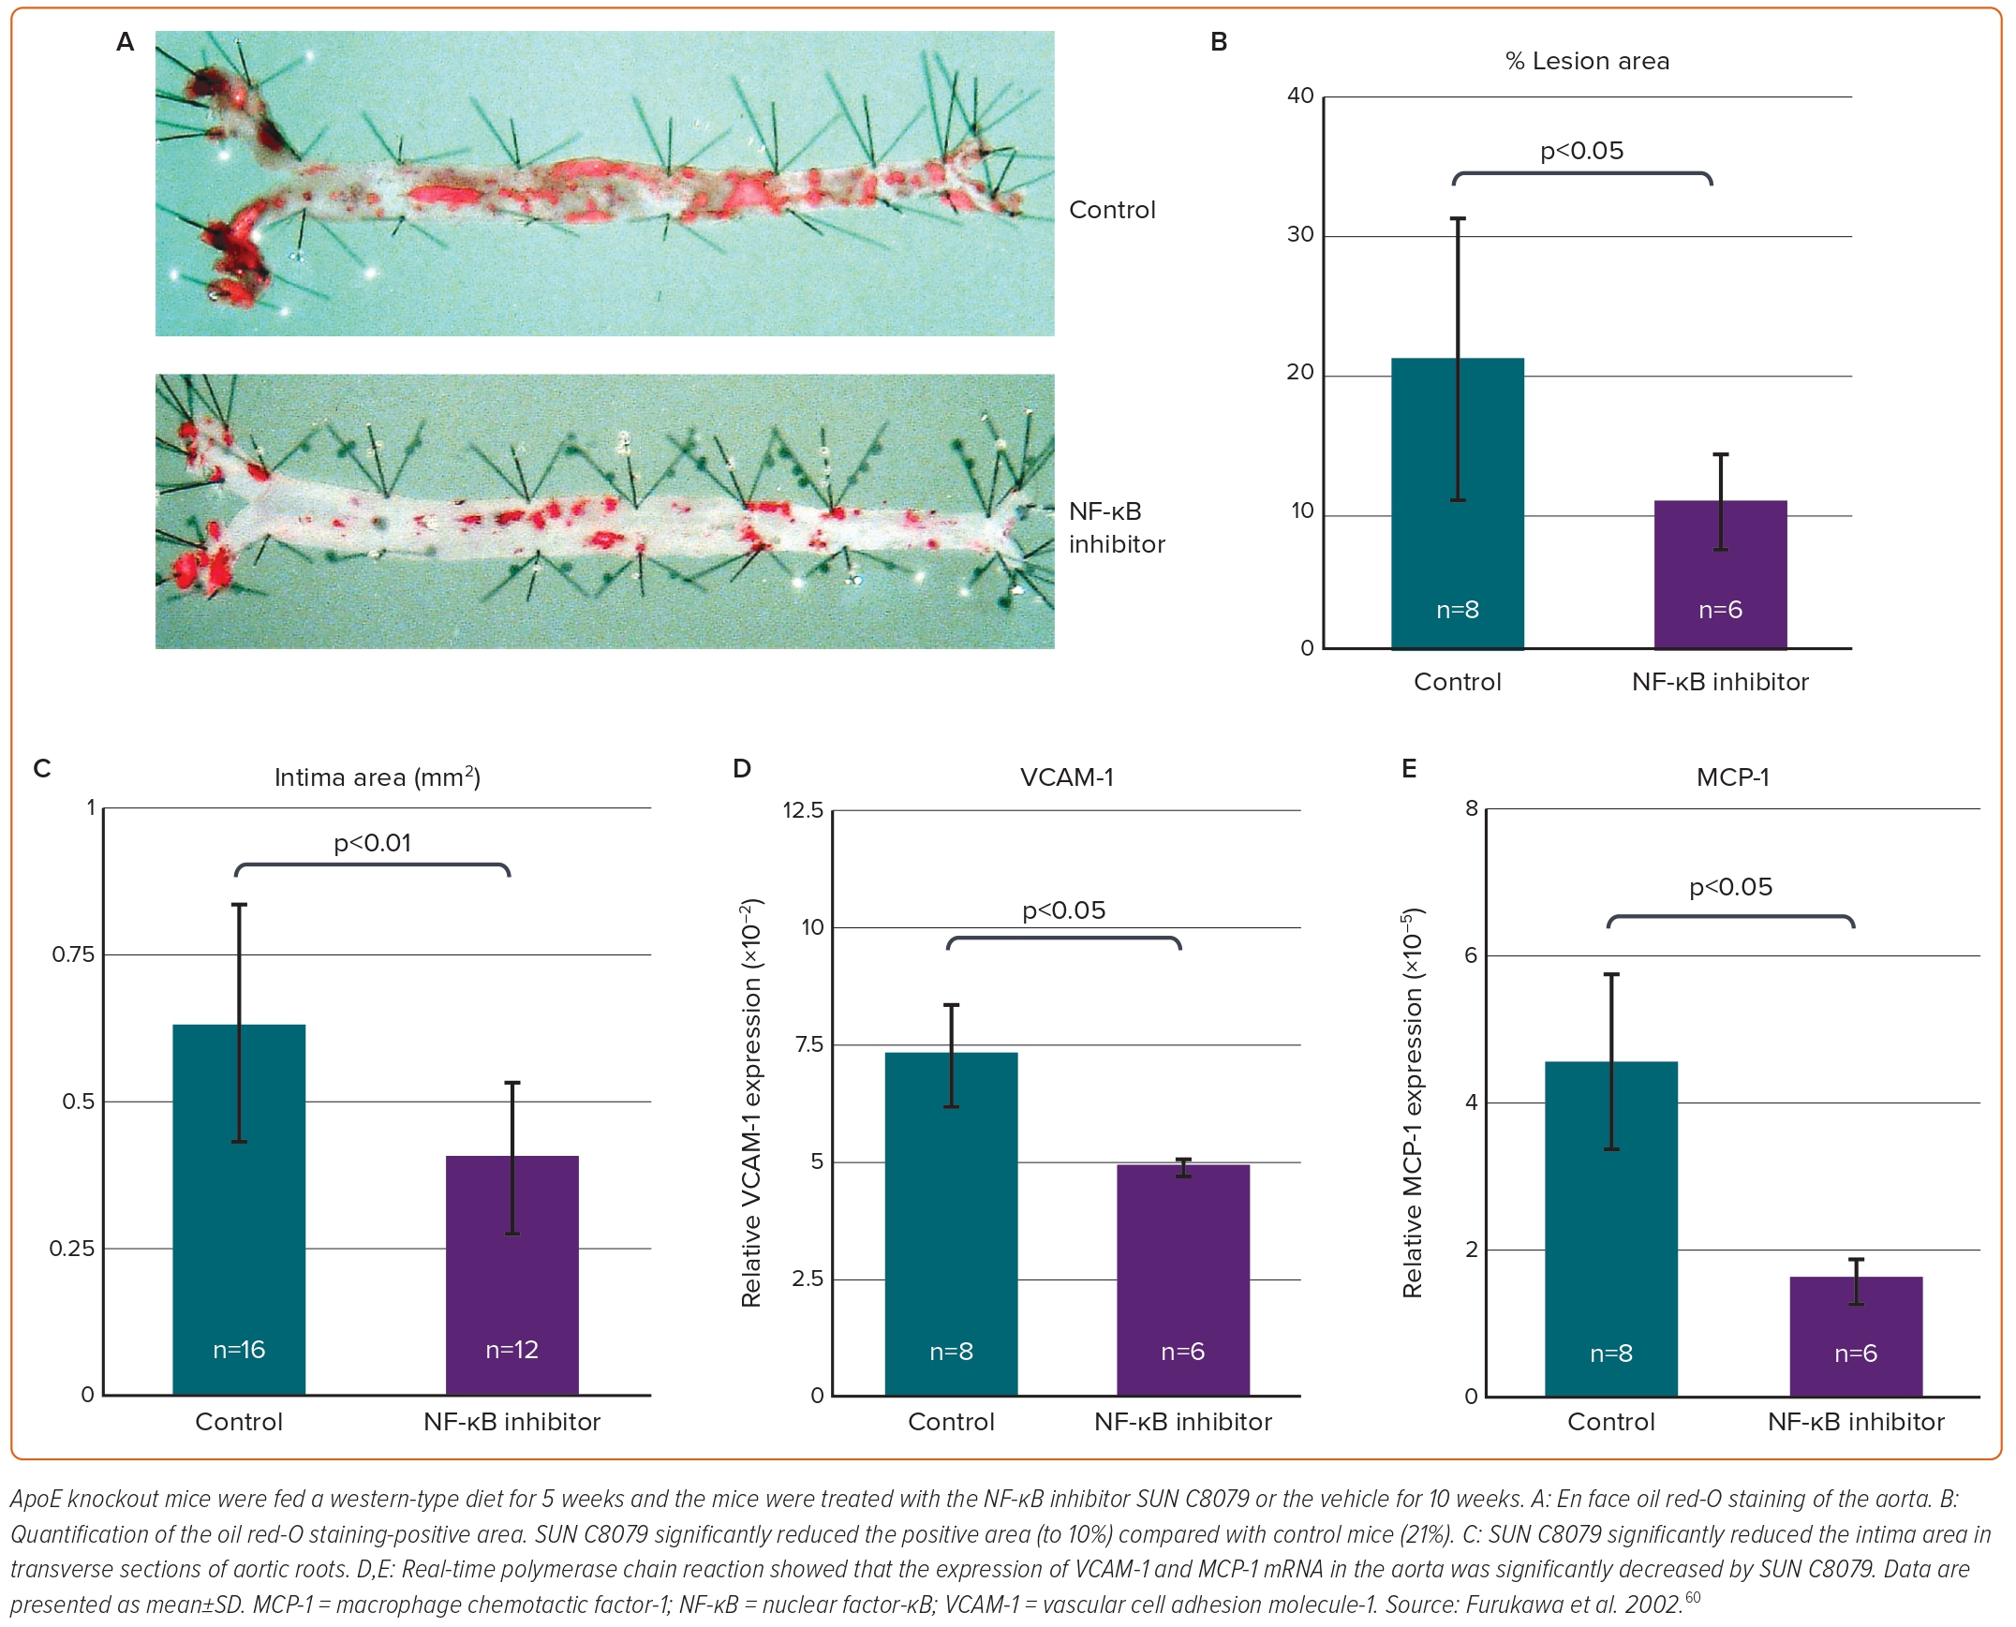
Matsumori A
Figure 3: Effects of SUN C8079 on the Expression of Proinflammatory Molecules and Atherosclerosis in Hyperlipidaemic ApoE-Deficient Mice
Citation: European Cardiology Review 2023;18:e40.
https://doi.org/10.15420/ecr.2023.10

