Slide 1
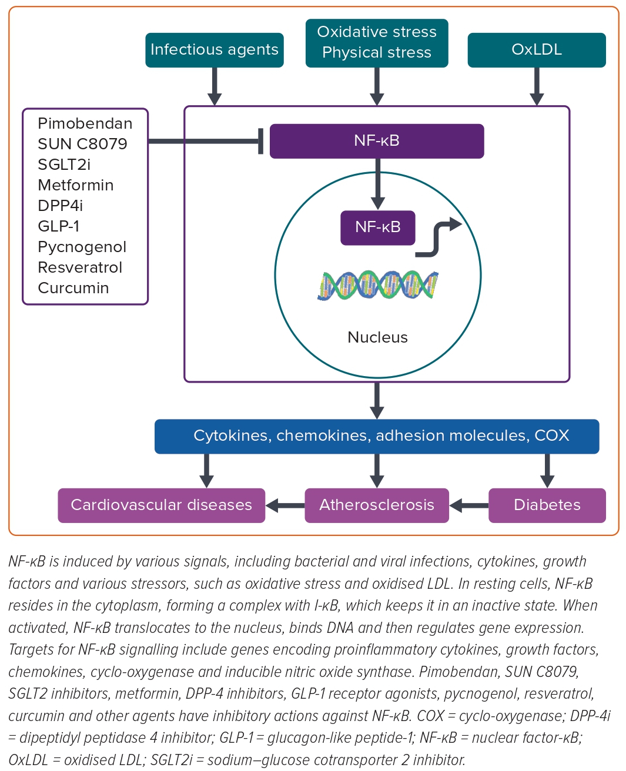
Matsumori A
Figure 4: Induction and Regulation of NF-κB
Citation: European Cardiology Review 2023;18:e40.
https://doi.org/10.15420/ecr.2023.10

