Slide 1
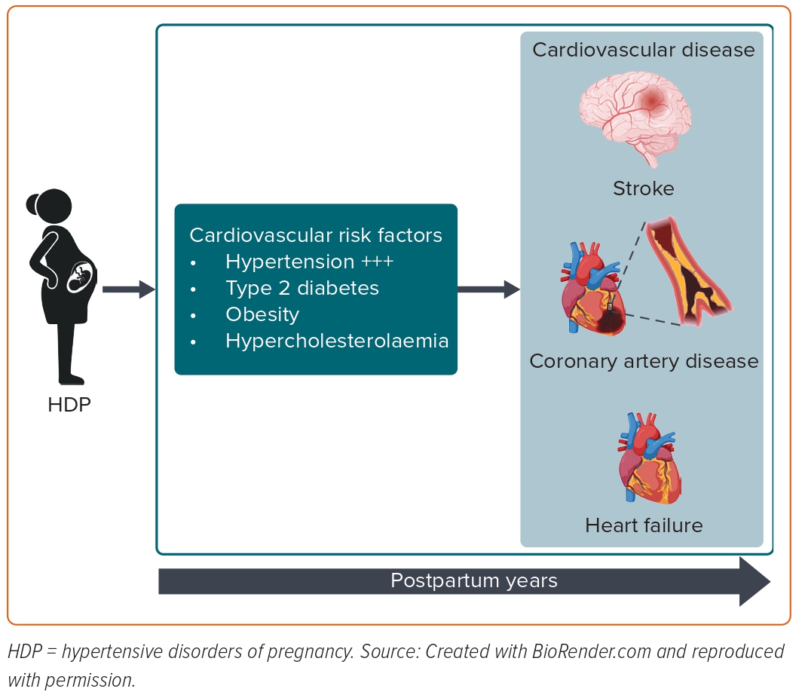
Giorgione V, Cauldwell M, Thilaganathan B
Figure 1: Cardiovascular Risk Factors are the Main Mediators of Cardiovascular Disease in Women with a History of Hypertensive Disorders of Pregnancy
Citation: European Cardiology Review 2023;18:e42.
https://doi.org/10.15420/ecr.2022.56

