Slide 1
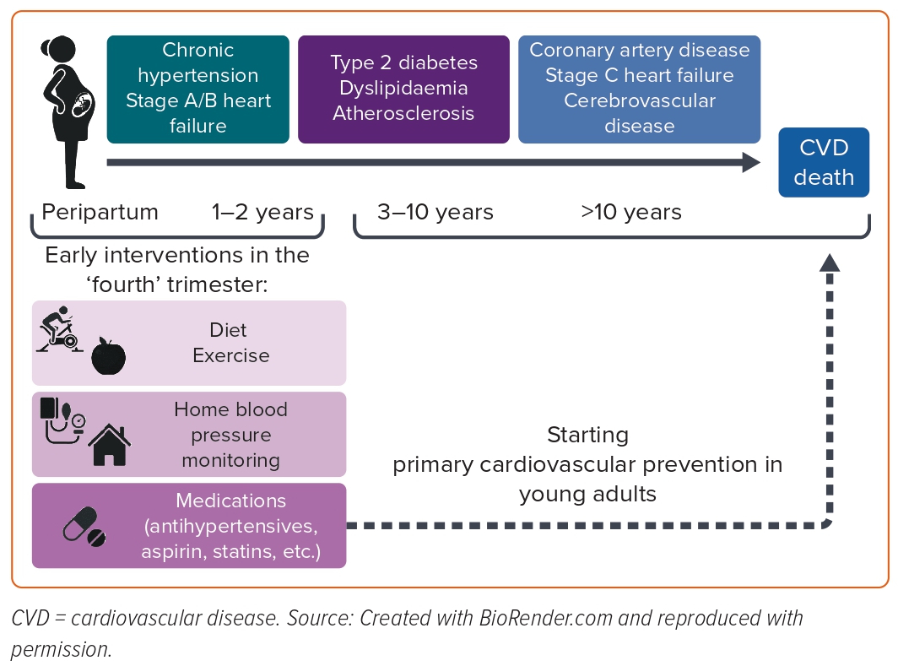
Giorgione V, Cauldwell M, Thilaganathan B
Figure 2: The Fourth Trimester Interventions in Women with Hypertensive Disorders of Pregnancy to Prevent Cardiovascular Disease
Citation: European Cardiology Review 2023;18:e42.
https://doi.org/10.15420/ecr.2022.56

