Slide 1
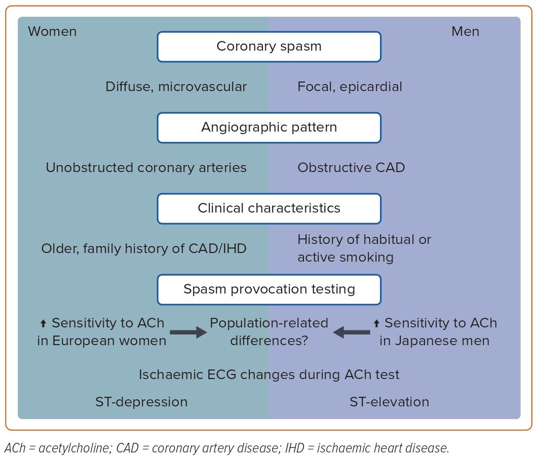
Ong P, Hubert A, Schwidder M, Beltrame JF
Figure 1: Differences in Angiographic Patterns, Clinical Characteristics and Diagnostic Features among Male and Female Patients with Coronary Spasm
Citation: European Cardiology Review 2023;18:e43.
https://doi.org/10.15420/ecr.2023.13

