Slide 1
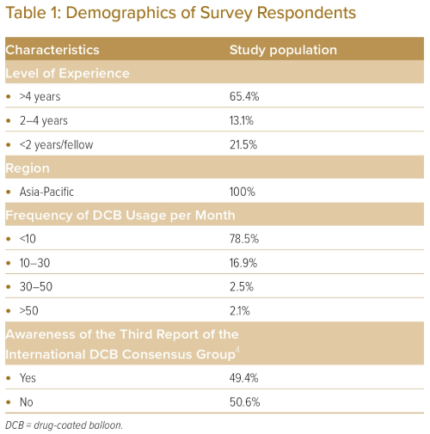
Ang AS, Li CK, Tan JW, JL Ong P
Table 1: Demographics of Survey Respondents
Citation: Journal of Asian Pacific Society of Cardiology 2023;2:e18.
https://doi.org/10.15420/japsc.2022.48

