Slide 1
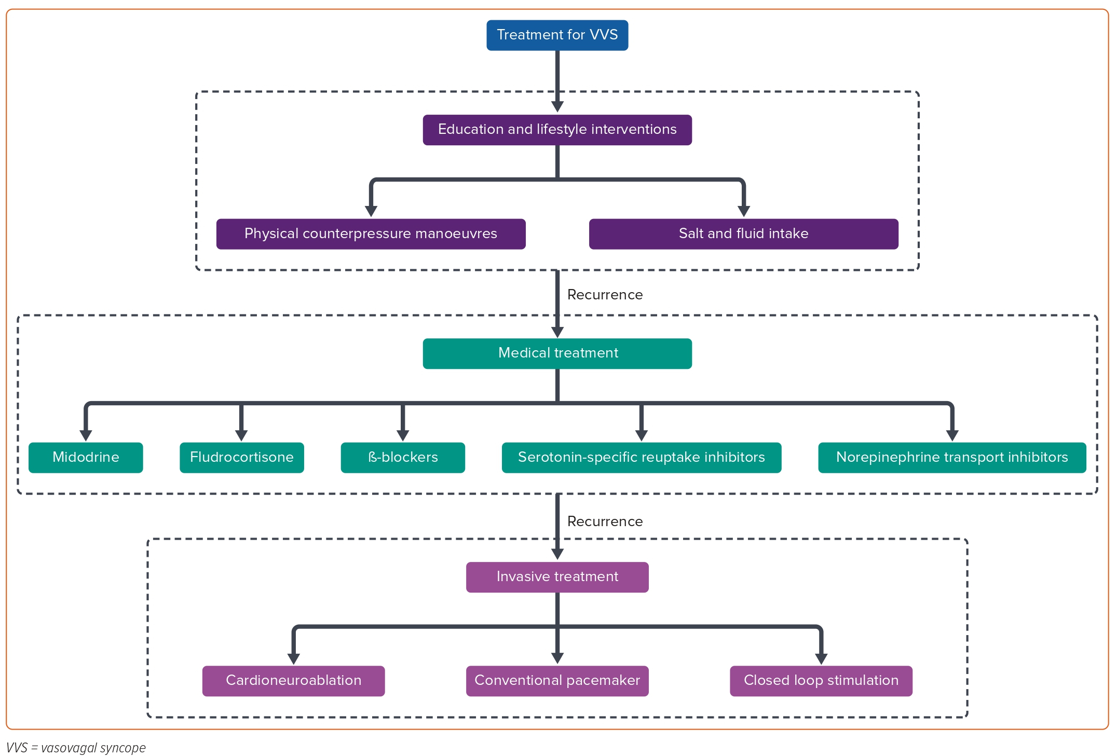
Li L, Po S, Yao Y
Figure 1: Flow Chart of Vasovagal Syncope Treatment
Citation: Arrhythmia & Electrophysiology Review 2023;12:e18.
https://doi.org/10.15420/aer.2023.02

