Slide 1
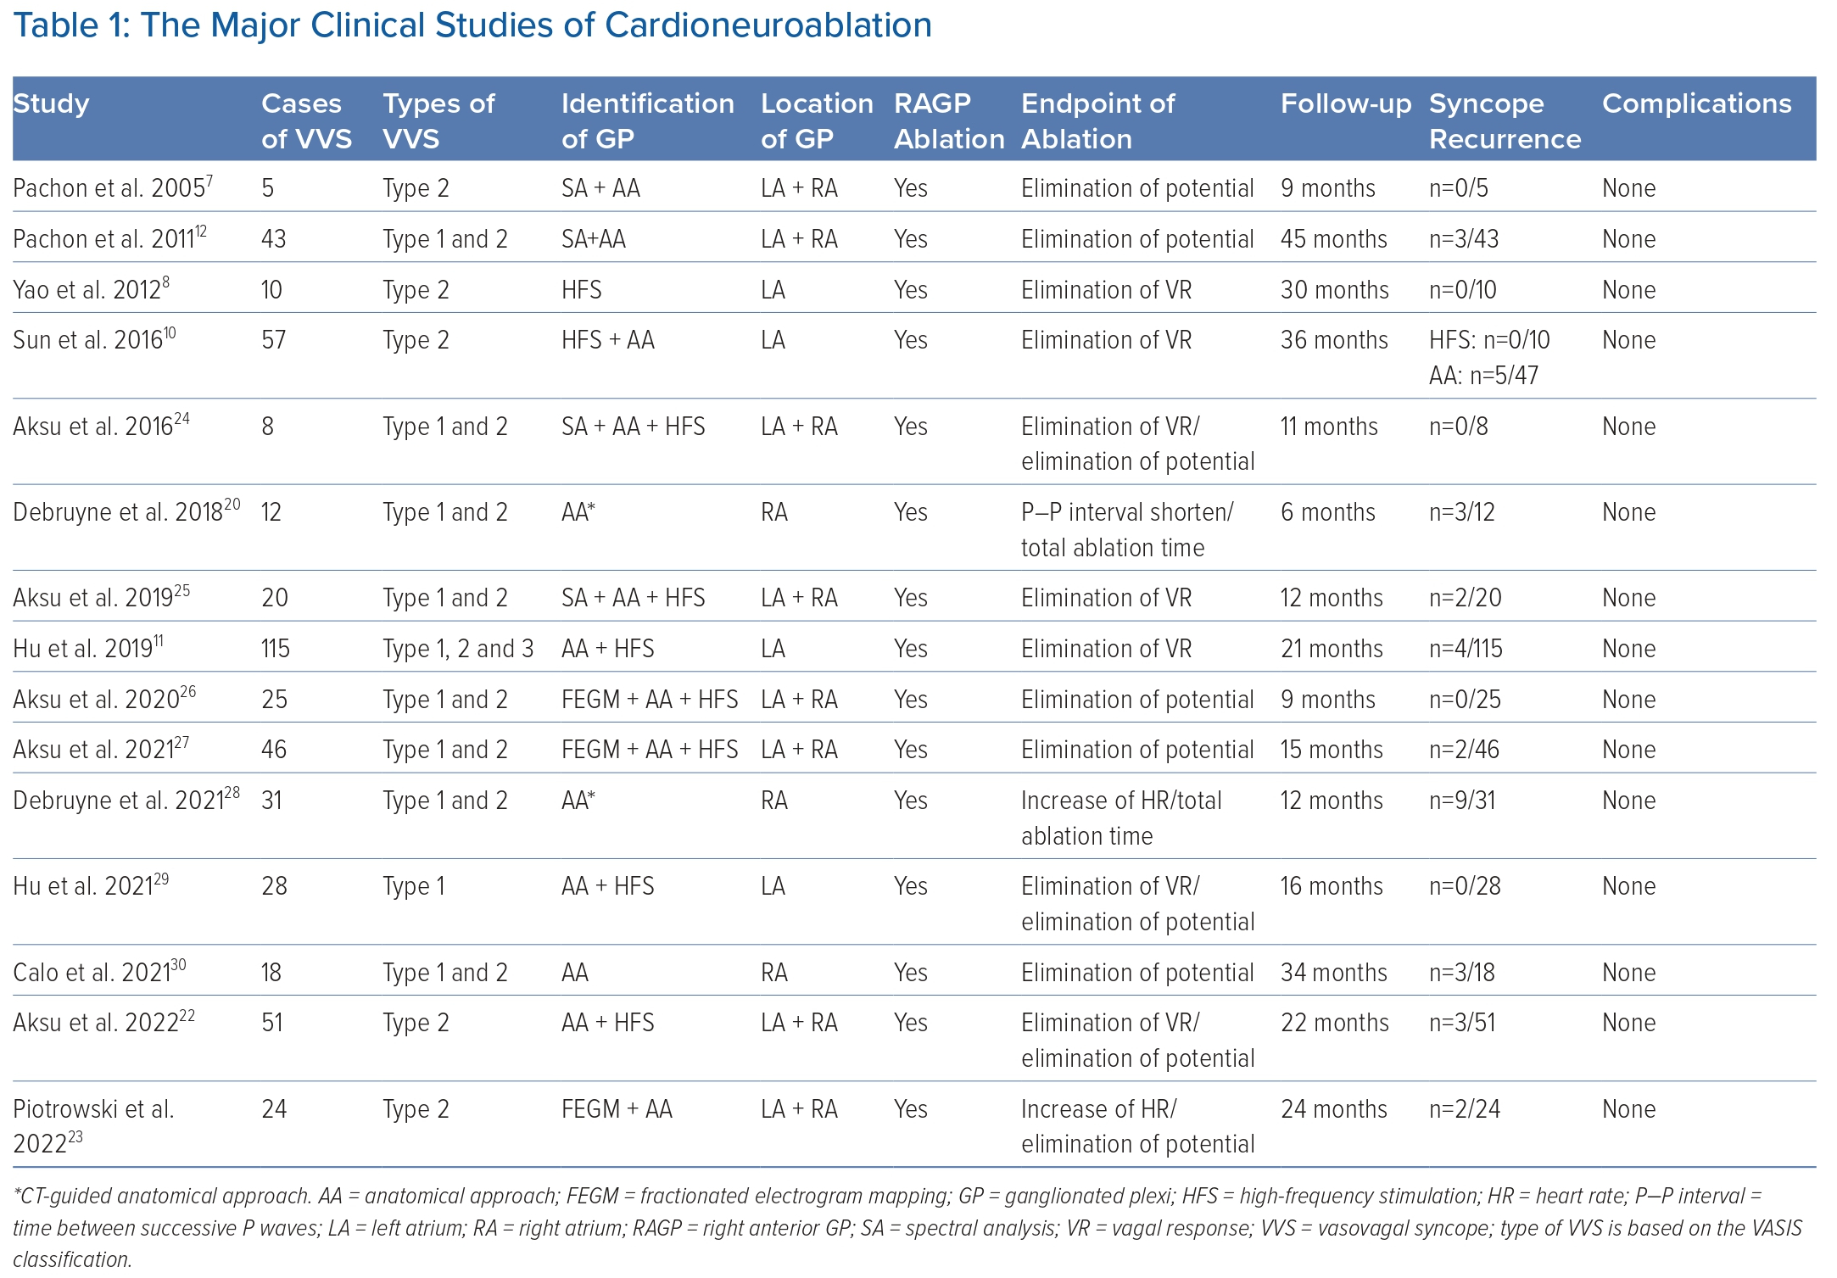
Li L, Po S, Yao Y
Table 1: The Major Clinical Studies of Cardioneuroablation
Citation: Arrhythmia & Electrophysiology Review 2023;12:e18.
https://doi.org/10.15420/aer.2023.02

