Slide 1
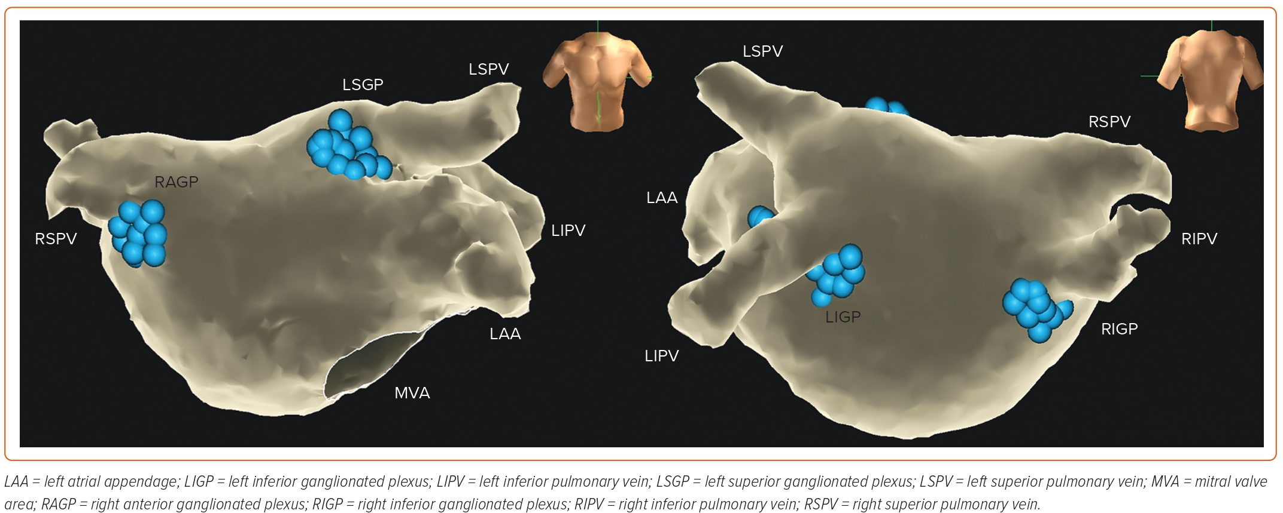
Li L, Po S, Yao Y
Figure 2: The 3D Endocardial Mapping of the Left Atrium and Locations of Ganglionated Plexi
Citation: Arrhythmia & Electrophysiology Review 2023;12:e18.
https://doi.org/10.15420/aer.2023.02

