Slide 1
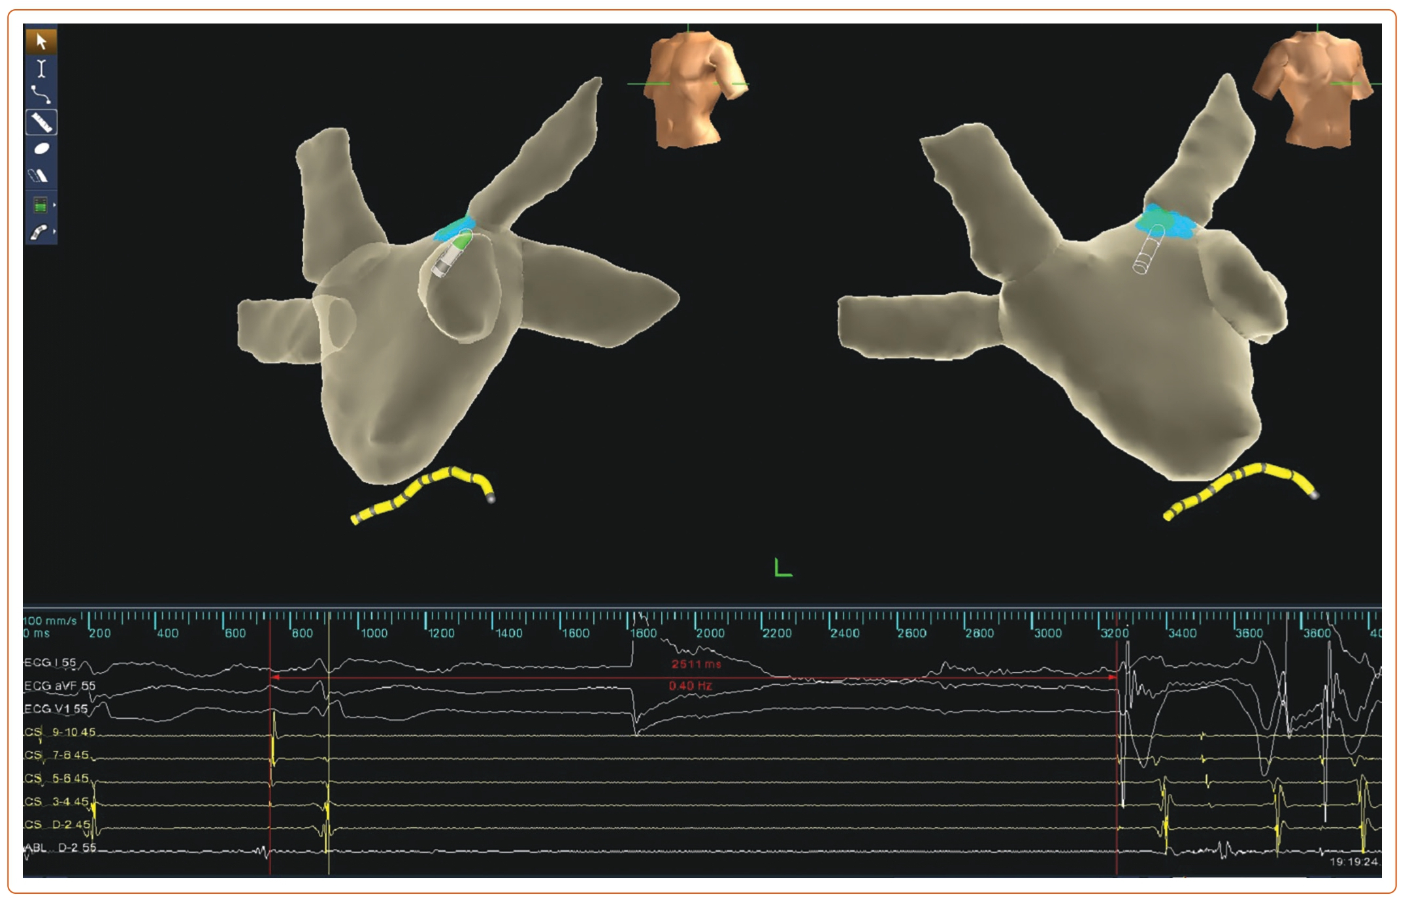
Li L, Po S, Yao Y
Figure 3: Illustration of the Vagal Response Induced by Radiofrequency Energy Delivery at the Left Superior Ganglionated Plexus, with Sinus Arrest Lasting 2,511 ms.
Citation: Arrhythmia & Electrophysiology Review 2023;12:e18.
https://doi.org/10.15420/aer.2023.02

