Slide 1
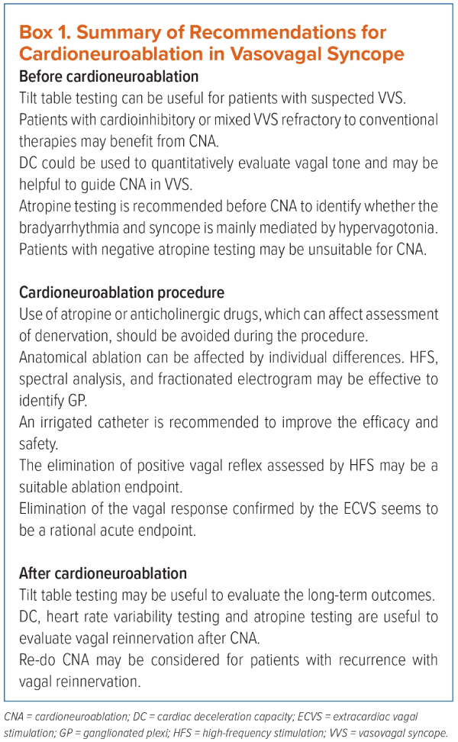
Li L, Po S, Yao Y
Box 1. Summary of Recommendations for Cardioneuroablation in Vasovagal Syncope
Citation: Arrhythmia & Electrophysiology Review 2023;12:e18.
https://doi.org/10.15420/aer.2023.02

