Slide 1
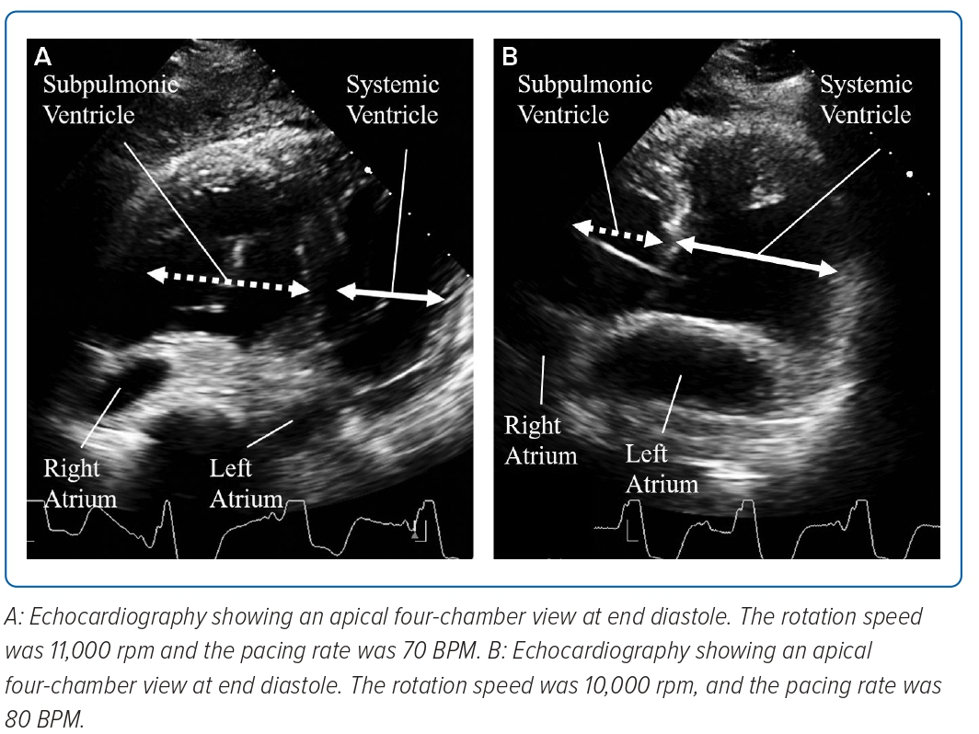
Fujita T, Koitabashi T, Ogiso S, Naruke T, Kitamura T, Miyaji K, Ako J
Figure 1: Ventricular Septum Shift
Citation: Journal of Asian Pacific Society of Cardiology 2023;2:e19.
https://doi.org/10.15420/japsc.2022.25

