Slide 1
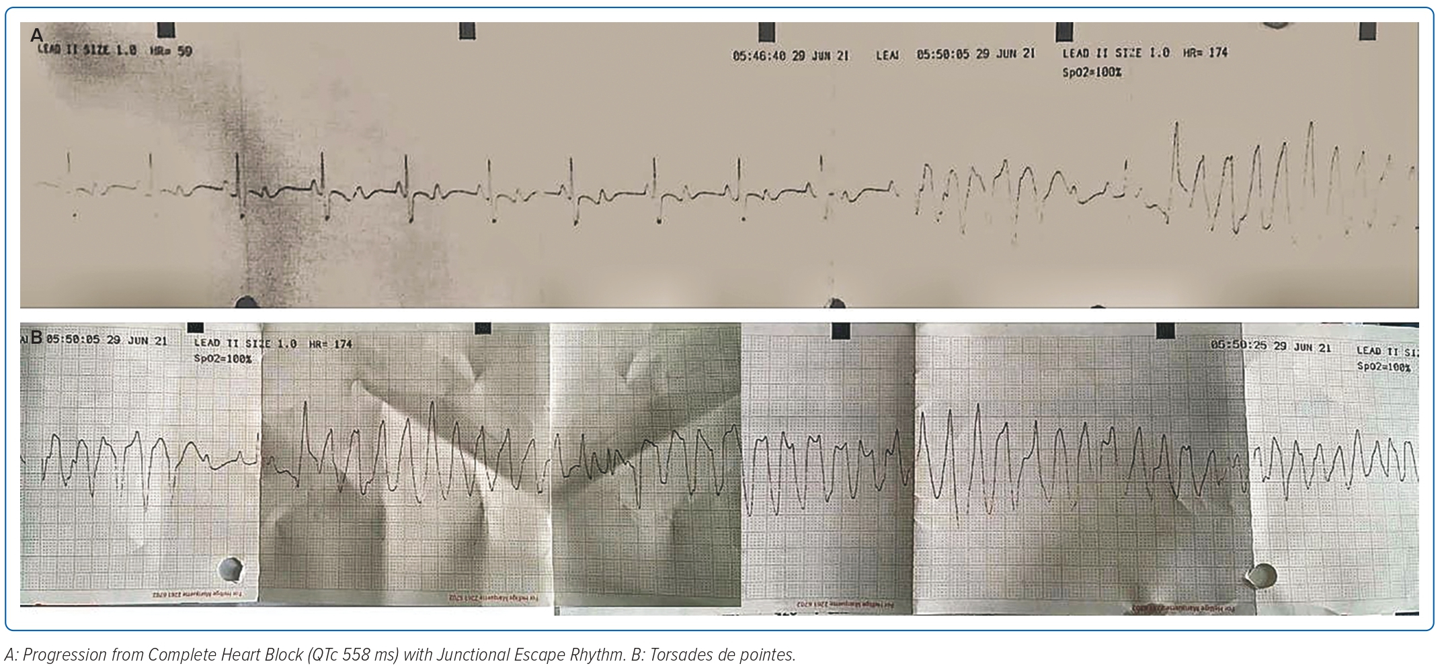
Hidayati F, Soraya H, Armein Hanafy D
Figure 1: Electrocardiography During an Epileptic Episode
Citation: Journal of Asian Pacific Society of Cardiology 2023;2:e20.
https://doi.org/10.15420/japsc.2022.55

