Slide 1
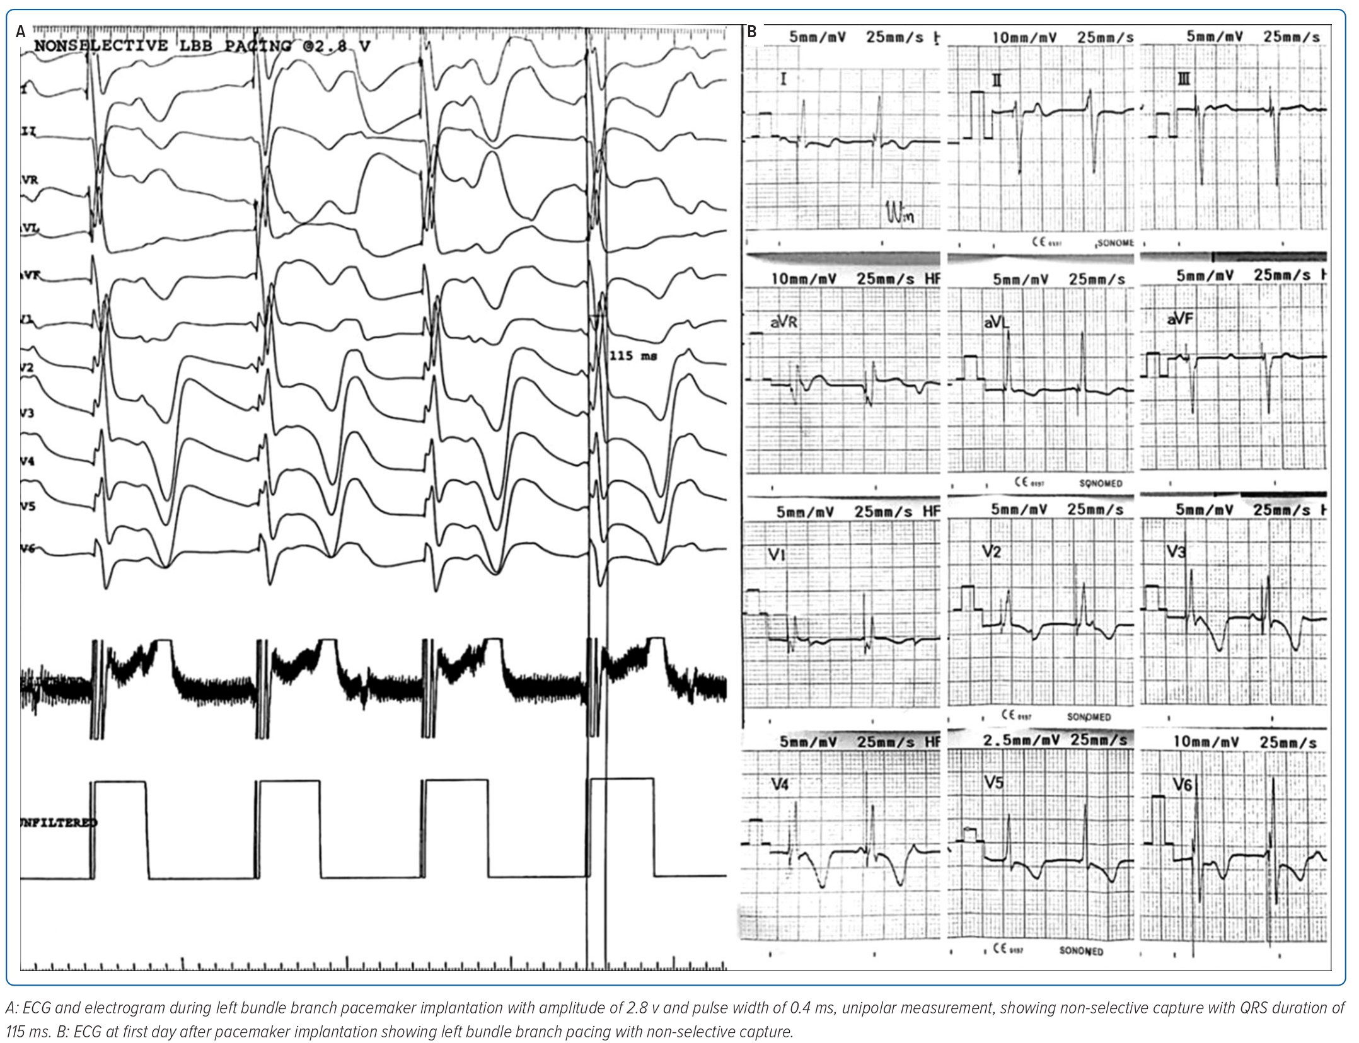
Hidayati F, Soraya H, Armein Hanafy D
Figure 3: Echocardiography and ECG During Left Bundle Branch Pacemaker Implantation and After Pacemaker Implantation
Citation: Journal of Asian Pacific Society of Cardiology 2023;2:e20.
https://doi.org/10.15420/japsc.2022.55

