Slide 1
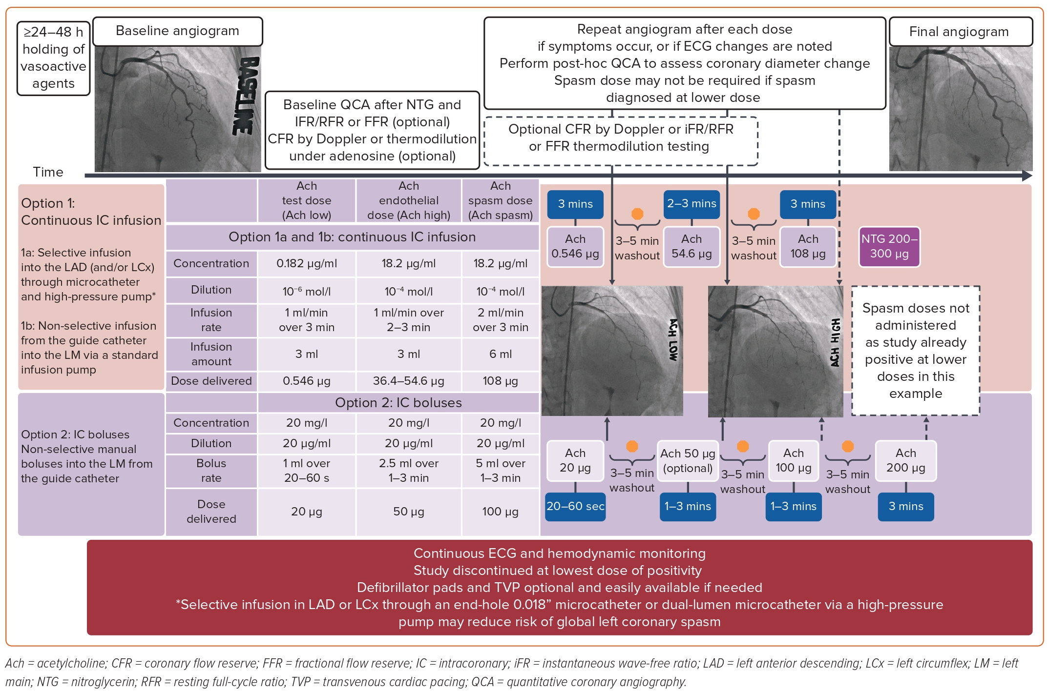
Huang J, Steinberg R, Brown MJ, Rinfret S, Toleva O
Figure 2: Spasm Provocation Testing with Incremental Doses of Acetylcholine
Citation: US Cardiology Review 2023;17:e07.
https://doi.org/10.15420/usc.2022.33

