Slide 1
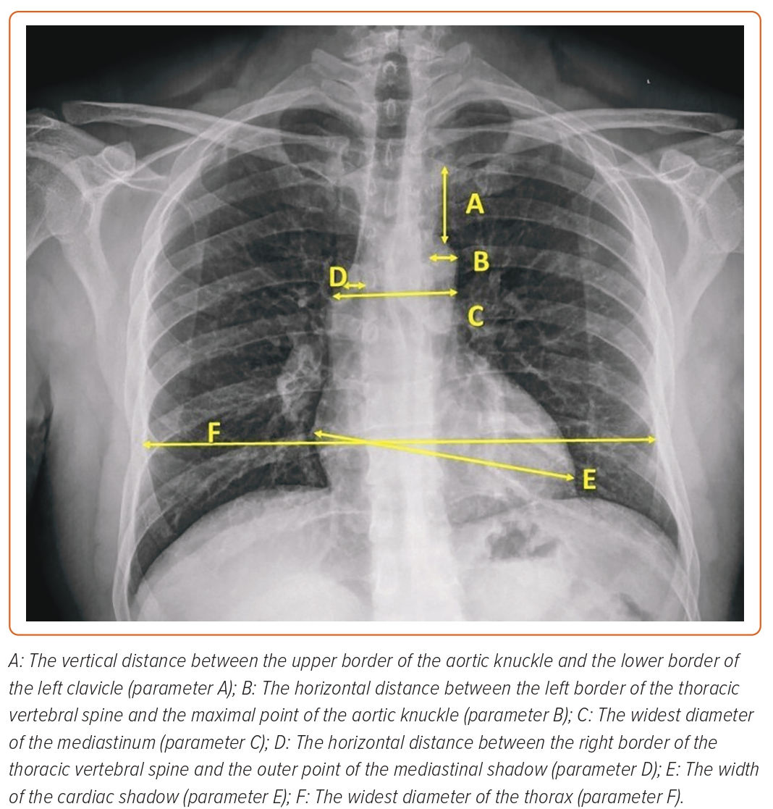
Elfar S, Onsy A, Farouk MA
Figure 1: Radiographic Parameters on Chest X-Ray
Citation: Interventional Cardiology 2023;18:e21.
https://doi.org/10.15420/icr.2023.04

