Slide 1
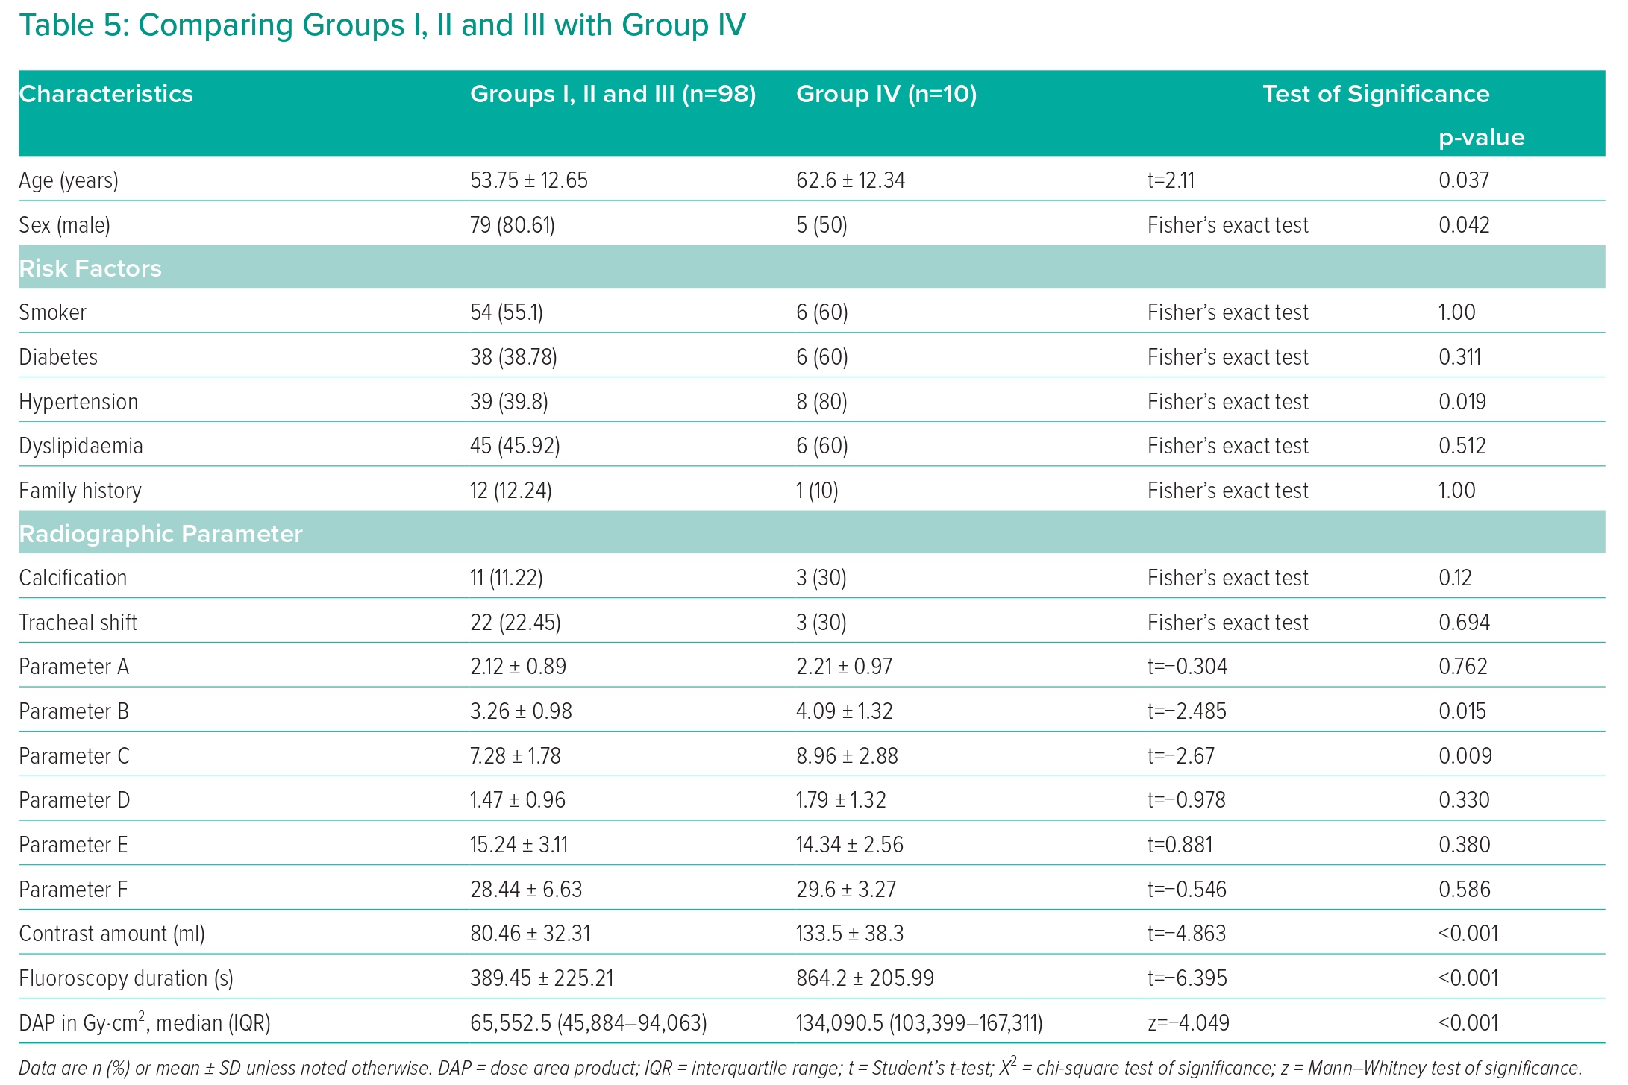
Elfar S, Onsy A, Farouk MA
Comparing Groups I, II and III with Group IV
Citation: Interventional Cardiology 2023;18:e21.
https://doi.org/10.15420/icr.2023.04

